Slide 1
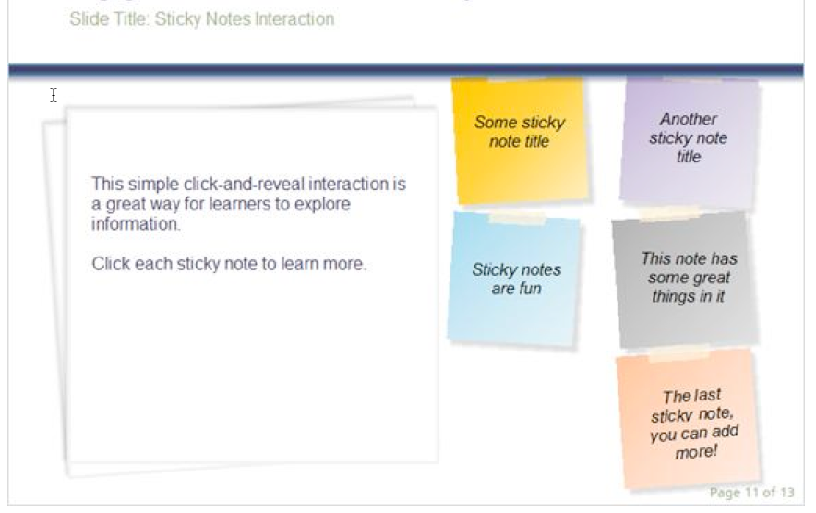


Mike, Post Its should be green color.
Select a sticky note on the right to learn more about each licensing type.
The most open
licensing options!
CC BY
This license lets others distribute, remix, tweak, and build upon your work, even commercially, as long as they credit you for the original creation. This is the most accommodating of licenses offered. Recommended for maximum dissemination and use of licensed materials.
Attribution
ShareAlike
Attribution
CC BY
Public Domain
Notes:
Public domain logo here: https://creativecommons.org/about/cc0
Other logos here: https://creativecommons.org/licenses/
Text for box:
CC BY (see above)
ShareAlike
This license lets others remix, tweak, and build upon your work even for commercial purposes, as long as they credit you and license their new creations under the identical terms. This license is often compared to “copyleft” free and open source software licenses. All new works based on yours will carry the same license, so any derivatives will also allow commercial use. This is the license used by Wikipedia, and is recommended for materials that would benefit from incorporating content from Wikipedia and similarly licensed projects.
Public Domain
When a work is in the public domain, it is free for use by anyone for any purpose without restriction under copyright law. Public domain is the purest form of open/free, since no one owns or controls the material in any way.

Slide 2

Mike, Post Its should be yellow.
Less open –
read the license!
Caution with these licensing options!
NoDerivs
This license allows for redistribution, commercial and non-commercial, as long as it is passed along unchanged and in whole, with credit to you.
Attribution
NonCommercial-ShareAlike
Attribution
NoDerivs
Attribution
NonCommercial-NoDerivs
Attribution
NonCommercial
Notes:
Public domain logo here: https://creativecommons.org/about/cc0
Other logos here: https://creativecommons.org/licenses/
Text for page:
NoDerivs (see above)
NonCommercial-ShareAlike
This license lets others remix, tweak, and build upon your work non-commercially, as long as they credit you and license their new creations under the identical terms.
NonCommercial-NoDerivs
This license is the most restrictive of our six main licenses, only allowing others to download your works and share them with others as long as they credit you, but they can’t change them in any way or use them commercially.
NonCommercial
This license lets others remix, tweak, and build upon your work non-commercially, and although their new works must also acknowledge you and be non-commercial, they don’t have to license their derivative works on the same terms.

