Slide 1
1.0 Introduction
Module 2: Introduction to Using OER for Math Instruction
Transforming Teaching, Learning, and Sharing

Slide 2

1.1 OER: More than Content
Open Educational Resources
Transform
Teaching & Learning

Slide 3
1.1 OER: More than Content
Open Educational Resources
No-Cost
Freely Reusable
Transform
Teaching & Learning

Slide 4
1.1 OER: More than Content
Open Educational Resources
Reuse
Redistribute
Revise
Remix
Retain
Facilitate Development of Student Practices
Transform
Teaching & Learning

Slide 5
1.1 OER: More than Content
Take advantage of the freedoms associated with OER to partner with students to create enriching and meaningful learning experiences.

Slide 6

2.0 What is Open Pedagogy?
Open Pedagogy
leverages the (retain), reuse, revise, remix, and redistribute permissions of open educational resources in order to enable students to extend and improve the official instructional materials.
In the McKay School of Education / Mark A. Philbrick / CC BY
-David Wiley, OER Expert

Slide 7
2.0 What is Open Pedagogy?
Open Pedagogy
leverages the (retain), reuse, revise, remix, and redistribute permissions of open educational resources in order to enable students to extend and improve the official instructional materials. The assignment is impossible without the permissions granted by open licenses.
In the McKay School of Education / Mark A. Philbrick / CC BY
-David Wiley, OER Expert

Slide 8
2.1 What is Open Pedagogy?
Sharing and adapting open educational resources is impacting teaching practice and student learning.
Isolation
Sharing & Collaboration

Slide 9
2.1 What is Open Pedagogy?
Sharing and adapting open educational resources is impacting teaching practice and student learning.
Consuming
Creating

Slide 10
2.1 What is Open Pedagogy?
Sharing and adapting open educational resources is impacting teaching practice and student learning.
THE
GUIDE
MY GUIDE
Generic
Personal

Slide 11
2.2 What is Open Pedagogy?
To open your classroom with open pedagogy involves implementing strategies that require:
Student use of OER
Student contribution to lesson development
Sharing between students and teachers

Slide 12
2.3 What is Open Pedagogy?
Student reuse, revision, remix, and redistribution of OER are associated with complex learning objectives.
Create
Understand
Apply
Evaluate
Analyze
Remember
OER Bloom‘s Taxonomy

Slide 13
2.3 What is Open Pedagogy?
Student reuse, revision, remix, and redistribution of OER are associated with complex learning objectives.
Create
Understand
Apply
Evaluate
Analyze
Remember
OER Bloom‘s Taxonomy

Slide 14
3.0 Open Pedagogy as an Instructional Approach
Open Pedagogy
Universal Design for Learning
Formative Assessment
Student-Centered Instruction
Differentiated Instruction

Slide 15
3.1 Open Pedagogy and Adult Learning Theory
Andragogy
Open Pedagogical concepts are shared with well-known adult learning theories.
Click to see how teaching practices in these adult learning theories are related to open pedagogy.
Review TEAL Fact Sheet No. 11 to learn more about each of these theories.
Transformative
Learning
Self-Directed
Learning

Slide 16
3.1 Open Pedagogy and Adult Learning Theory
Andragogy
Principles of Andragogy
Set a cooperative climate for learning in the classroom.
Develop learning objectives based on the learner’s needs, interests, and skill levels
Work collaboratively with the learner to select methods, material, and resources for instruction
Transformative
Learning
Self-Directed
Learning
TEAL Center Fact Sheet No. 11: Adult Learning Theories

Slide 17
3.1 Open Pedagogy and Adult Learning Theory
Andragogy
Principles of Transformative Learning
Develop and use learning activities that explore and expose different points of view
Promote student autonomy, participation and collaboration
Explore alternative perspectives and engage in problem-solving and critical reflection
Transformative
Learning
Self-Directed
Learning
TEAL Center Fact Sheet No. 11: Adult Learning Theories

Slide 18
3.1 Open Pedagogy and Adult Learning Theory
Andragogy
Principles of Self-Directed Learning
Help learners develop strategies for decision-making and self-evaluation of work
Help learners assess their skill level and their needs in order to determine learning objectives
Help learners to match appropriate resources and methods to the learning goal
Transformative
Learning
Self-Directed
Learning
TEAL Center Fact Sheet No. 11: Adult Learning Theories

Slide 19


3.2 Other Guiding Principles & Practices
Performance standards and teacher and student practices also impact instruction and learning.
These guidelines help all learners succeed and be prepared for assessments, success in the workplace and further education.
Student Math Practices
Many of these guidelines promote learning experiences that develop knowledge and skills through the active involvement of students.
Teaching Practices

Slide 20


3.3 Other Guiding Principles & Practices
Student Math Practices
Teaching Practices
OER can help students develop practices such as the College and Career Readiness Mathematics Standards.
Click to view
OER integration supports teacher practices like those promoted by the National Council of Teachers of Mathematics. Click to view

Slide 21

3.4 Student Mathematical Practices
College & Career Readiness Standards for Mathematical Practice
Make sense of problems and persevere in solving them
Reason abstractly and quantitatively
Construct viable arguments and critique the reasoning of others
Model with mathematics
Use appropriate tools strategically
Attend to precision
Look for and make use of structure
Look for and express regularity in repeated reasoning

Slide 22
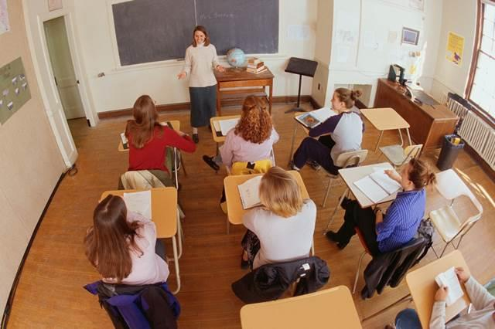
3.5 Mathematics Teaching Practices
NCTM Mathematics Teaching Practices
Establish mathematics goals to focus learning
Implement tasks that promote reasoning and problem solving
Use and connect mathematical representations
Facilitate meaningful mathematical discourse
Pose purposeful questions
Build procedural knowledge
Support productive struggle in learning mathematics

Slide 23

3.6 What Shapes How You Teach?
What are the
practices, theories, strategies, guidelines and approaches
that shape how
you teach?

Slide 24
4.0 How Open Is Your Classroom?
The questions in this self–assessment are derived from the basic tenets of open pedagogy being compiled by educators for OERu (OER Universitas), a network of organizations with similar goals for OER use and open education.
As discussed earlier in this presentation, many of the instructional practices that are frequently used for instruction of adult learners are also tenets of open pedagogy.
The questions are a mix of how you and your students are using OER for teaching and learning, how students are involved in the development of lesson objectives, and how students collaborate with other learners to achieve outcomes with OER. For this reason your classroom may be more open than you realized. Complete the self-assessment to find out how open your classroom is.
Begin
Self-Assessment

Slide 25
4.0 How Open Is Your Classroom?
Answer the questions by responding Most of the time, Some of the time or Never
Do you use open materials for teaching and learning?
Do you share materials created and adapted by you and your learners with a CC license?
Are learners required to revise, remix, identify or redistribute OER to meet instructional objectives?
Do students have input in their learning objectives?
Do learning and performance objectives reflect needed real world skills and outcomes?

Slide 26
4.0 How Open Is Your Classroom?
Answer the questions by responding Most of the time, Some of the time or Never
Are learning experiences authentic?
Are learning experiences integrated with opportunities for students to reflect on their work and learning?
Do students learn through using social networked media e.g. by joining learning communities?
Do you provide supports to learners with development of their skills and strategies for open and lifelong learning (i.e. self-directed strategies, digital information literacy)?
Is learner understanding and skills demonstrated through assessment embedded in completion of course activities?

Slide 27
4.0 How Open Is Your Classroom?
Based on your responses your classroom is open most of the time.
Finding ways to use OER with your students and integrate open practices into instruction is likely not a challenge for you. As you develop your lesson plan for this course, build on the open practices you’re already using to test new ways of working with OER and contributing your ideas to the open community.

Slide 28
5.0 Principles of Open Pedagogy
Teaching and learning materials must be OER
!
Learners identify and adapt OER to meet instructional objectives
!
Set objectives that reflect needed real world skills and outcomes
Support development of self-directed and open learning strategies
Design authentic and reflective learning experiences
Require student participation in social networked media
Permit learner input in their learning objectives
Embed assessment in course activities

Slide 29
5.1 Review Principles of Open Pedagogy
Essential Principles
First and foremost, you must include OER in the lesson and require students to revise, remix, or identify and redistribute OER to meet instructional objectives.
Authentic Learning Objectives & Experiences
Students should be involved in determining learning objectives, which reflect needed real world skills and outcomes.
Learning experiences should be authentic and reflective.
Continued Student Growth & Skills Development
Activities should engage students in learning by using social media and foster the development of strategies for self-directed learning, digital information literacy, and open learning.
Finally, assessment should be integrated into course activities to provide students with opportunities to demonstrate learning and to give both teachers and learners information needed to guide learning.
Notes:
Review the principles of open pedagogy before moving on.

Slide 30
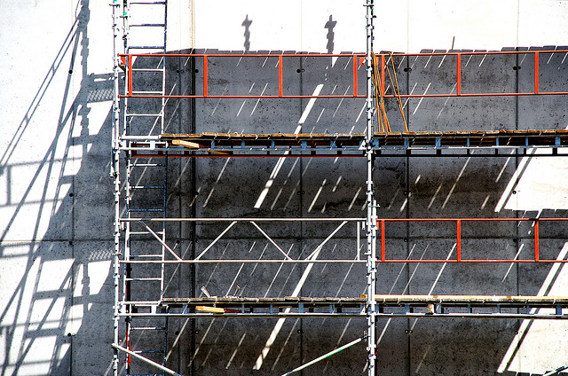
5.2 Conditions that Support Student OER Use
Create a safe space for learners to share their goals, experiences, and engage with the instructor and other learners
Provide a basis for student self-assessment of their work
Provide formative feedback to learners to guide their use of OER
Scaffolding / Astrid Westvang / CC BY NC ND

Slide 31
6.0 Open Pedagogical Practices in Context
Lesson Description
An adult education GED teacher begins planning for the semester by setting goals based on the College and Career Readiness Standards for Adult Education (Pimentel, 2013). Learning objectives for a planned lesson include building an understanding of ratio concepts and using ratio reasoning to solve problems that will appear on the GED.
To demonstrate the lesson the teacher finds an OER video on ratio concepts. Prior to using the OER with students, the teacher revises it to make it appropriate for adult learners by adding captions that define key words as they are occur in the video narration.
The teacher presents a lesson on ratio concepts in the classroom and shows her revised OER video before having students discuss ratio concepts and work in small groups to complete practice problems. She also shares the video online with learners so that they can refer to it while completing homework problems.

Slide 32
6.0 Open Pedagogical Practices in Context
Lesson Description
An adult education GED teacher begins planning for the semester by setting goals based on the College and Career Readiness Standards for Adult Education (Pimentel, 2013). Learning objectives for a planned lesson include building an understanding of ratio concepts and using ratio reasoning to solve problems that will appear on the GED.
To demonstrate the lesson the teacher finds an OER video on ratio concepts. Prior to using the OER with students, the teacher revises it to make it appropriate for adult learners by adding captions that define key words as they are occur in the video narration.
The teacher presents a lesson on ratio concepts in the classroom and shows her revised OER video before having students discuss ratio concepts and work in small groups to complete practice problems. She also shares the video online with learners so that they can refer to it while completing homework problems.

Slide 33

6.1 Open Pedagogical Practices in Context
Open Lesson Plan
Set lesson objectives based on content standards
Revise OER video on ratios
Present OER video to learners
Assign students to small groups
to complete practice problems
5. Share the OER video online for learners
to reference as they complete homework

Slide 34

6.1 Open Pedagogical Practices in Context
Open Lesson Plan
Set lesson objectives based on content standards
Revise OER video on ratios
Present OER video to learners
Assign students to small groups
to complete practice problems
5. Share the OER video online for learners
to reference as they complete homework
Students
organize & transform the OER

Slide 35
6.1 Open Pedagogical Practices in Context
Open Lesson Plan
Set lesson objectives based on content standards
Revise OER video on ratios
Present OER video to learners
Assign students to small groups
to complete practice problems
5. Share the OER video online for learners
to reference as they complete homework
Students
organize & transform the OER
Students remix the OER video with other OER

Slide 36
6.1 Open Pedagogical Practices in Context
Open Lesson Plan
Set lesson objectives based on content standards
Revise OER video on ratios
Present OER video to learners
Assign students to small groups
to complete practice problems
5. Share the OER video online for learners
to reference as they complete homework
Require students to identify other OER on the lesson topic
Students
organize & transform the OER
Students remix the OER video with other OER

Slide 37
6.1 Open Pedagogical Practices in Context
Open Lesson Plan
Set lesson objectives based on content standards
Revise OER video on ratios
Present OER video to learners
Assign students to small groups
to complete practice problems
5. Share the OER video online for learners
to reference as they complete homework
&
REMEMBER
Require students to identify other OER on the lesson topic
Students
organize & transform the OER
Provide feedback &
share student OER
Students remix the OER video with other OER

Slide 38

7.0 Summary
OER can help to make learning more
Collaborative
Student-directed
Personalized

Slide 39
7.0 Summary
Teaching with OER
Removes barrier to access to instructional materials
Gives students control over content
Provides opportunities for students to share resources and knowledge

Slide 40
7.0 Summary
Open pedagogy and teaching with OER alongside other adult education practices can enrich learning.

Slide 41
7.1 Questions for Reflection
What is your vision for an open math class?
?
What practices will guide your vision of open instruction?
What does open pedagogy mean to you?
What practices will you help students to develop in your open math class?

