Slide 1

A Parent’s Survival Guide to Marijuana
Notes:
Music rises and title graphic animates in.
VO: “A Parent’s Survival Guide to Marijuana”

Slide 2
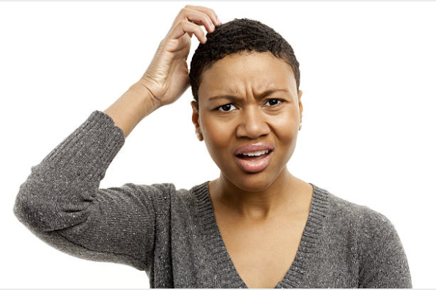
What Is This?
Notes:
Parent #1 on camera:
“I found some odd looking items I’d never seen before in my teenager’s room. How can I tell if they’re used to ingest marijuana?”

Slide 3
What Is This?
iStock photo ID:849668706
iStock photo ID:671382536
iStock photo ID:697552222
Notes:
VO: “Today’s teenagers are consuming marijuana in a variety of ways that are likely unfamiliar to their parents. We’ll discuss a few of them here.”

Slide 4
Forms of Marijuana - Dabs
Wax
Shatter
Budder
Butane Hash Oil (BHO
iStock photo ID:855257270
iStock photo ID:869423136
Notes:
VO: “Dabs are concentrated doses of cannabis that are made by extracting THC and other cannabinoids using a solvent like butane or carbon dioxide, resulting in sticky oils also commonly referred to as wax, shatter, budder, and butane hash oil (BHO). Though it may be unfamiliar to many parents, there are over 9,000 videos online showing how to make dabs.
Cycle through images and fly in words in sync with VO: Wax, Shatter, Budder, Butane Hash Oil (BHO)

Slide 5
Forms of Marijuana – Dabs
Stock photo ID:499738699
Notes:
VO: “Vape pens are used to smoke “dabs” and give the appearance of a pen or electronic cigarette. Their use may not be obvious because they do not produce smoke or any odor.
A dab may contain 70% to 90% of THC. Users may have a high that lasts up to 24 hours.”

Slide 6
Forms of Marijuana – Edibles
iStock photo ID:822812918
iStock photo ID:869548628
iStock photo ID:669601034
Notes:
VO: Edibles are food products infused with marijuana. Though smoking marijuana is the most prevalent method of consumption, eating marijuana is quickly becoming a popular way to consume the drug.
Brownies used to be among the most common food products infused with marijuana, however, almost any food product may be infused with marijuana and eaten.

Slide 7
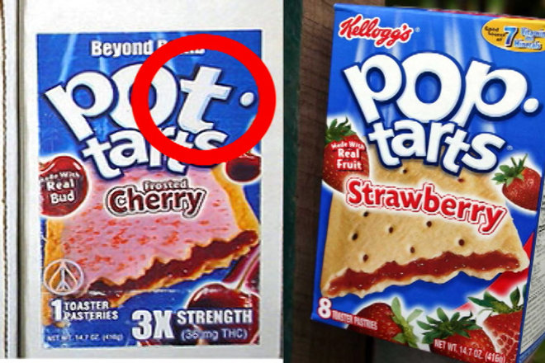
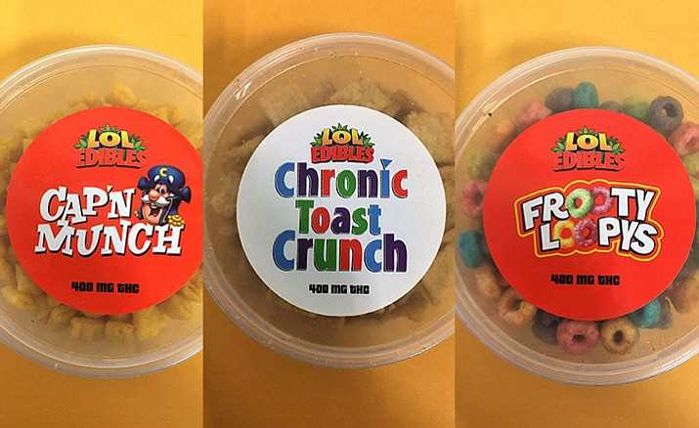
Forms of Marijuana – Edibles
Question for Joelle: Are these images ok to use in the video?
Notes:
VO: The effects from smoking marijuana only take minutes to appear. Edibles, however, take between 1-3 hours before the effects are noticeable because food is absorbed into the bloodstream through the liver.
Because it takes longer, the user may end up consuming larger amounts of the drug while thinking the drug isn't working. Moreover, overdose symptoms from eating marijuana are often more severe than symptoms of an overdose from smoking marijuana.

Slide 8
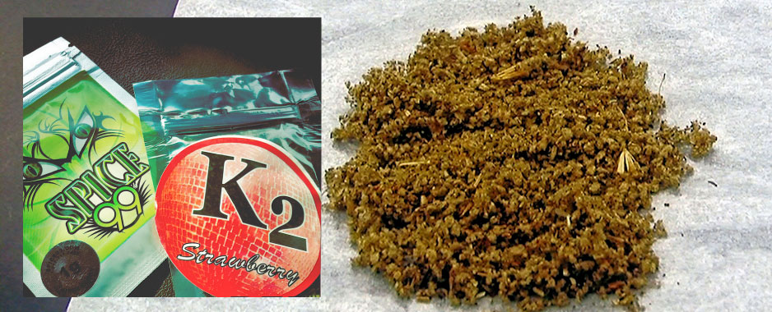
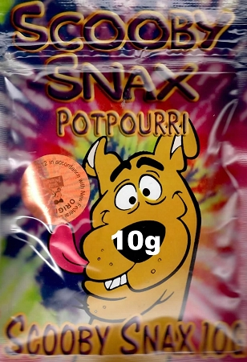
Forms of Marijuana – Synthetics
Ok to use these images?
Notes:
VO: “Another new form of marijuana is ‘Synthetics’, sometimes called ’K2’ or ‘Spice’. Synthetics are a mixture of herbs and spices sprayed with a synthetic compound chemically made to mimic to THC.
No part of synthetics come from the cannabis plant. It addition to being smoked, it can be added to food and drinks.

Slide 9
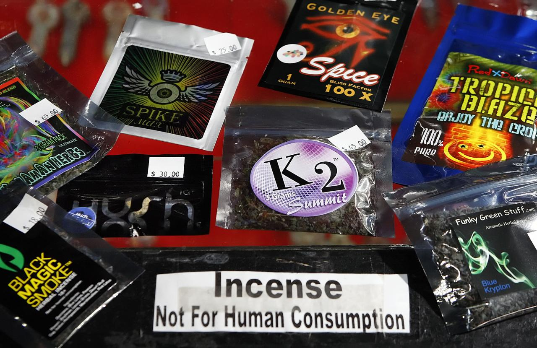
Forms of Marijuana – Synthetics
Hallucinations
Vomiting
Confusion and Paranoia
Rapid heart rate
Myocardial Ischemia
Heart Attack
Psychotic and Violent Behavior
Renal Failure
Anxiety
Tremor
Seizures
Loss of Consciousness
High Blood Pressure
Death
Notes:
VO: “Because synthetics are labeled “Not For Human Consumption” and are marketed as an incense type product, the FDA can not regulate it nor make it illegal.
Synthethics are particularly dangerous because toxicity of the components can vary and be unknown.
Side effects of Spice can include:
Hallucinations
Vomiting
Confusion and Paranoia
Rapid heart rate
Myocardial Ischemia
Heart Attack
Psychotic and Violent Behavior
Renal Failure
Anxiety
Tremor
Seizures
Loss of Consciousness
High Blood Pressure
Death
”

Slide 10

Dependence
Notes:
Parent #2 on camera:
“If my daughter uses Marijuana, what are the odds that she will become dependent?“

Slide 11
Dependence
1 in 11 adults and 1 in 6 youth can become dependent
1 in 3 develop problem use
Notes:
VO: “Research finds that about 1 in 11 adults and 1 in 6 youth who use marijuana can become dependent, with 1 in 3 developing some form of problem use. Earlier use is linked to greater risk of dependence on marijuana and other drugs.”
Animate silhouette outlines into place at outset.
Fill in each silhouette in sync with the VO.

Slide 12

Long Term Effects
Notes:
Parent #3 on camera:
“Could Marijuana use permanently affect my kids’ brains?"

Slide 13
Long Term Effects
Marijuana can impair:
•learning
•memory
•math
•reading levels
iStock ID# 182410808
Notes:
VO: “According to the Journal of American Academic Child & Adolescent Psychiatry, heavy marijuana use impairs young people’s ability to concentrate and retain information. Kids who use marijuana regularly can decrease their IQ and impair learning, memory, math and reading levels. These changes can be permanent. “
Show certain puzzle pieces of brain fading out one by one.

Slide 14
Long Term Effects of Marijuana
Teen marijuana use:
•Lowers academic performance
•Increases truancy & drop out
•Reduces likelihood of graduation
•Higher risk of future unemployment
Stock photo ID:466007300
Stock photo ID:641686490
Notes:
VO: “Research shows that teen marijuana use :
• Lowers academic performance
• Increases truancy & drop out
• Reduces likelihood of graduation
• Higher risk of future unemployment “

Slide 15
Did You Know…
There is no difference between “marijuana” and “cannabis.”
iStock photo ID:821837594
Notes:
Short music motif intro.
VO: “Did you know… There is no difference between “marijuana” and “cannabis.”
The word “marijuana” is slang used to describe the drug derived from the cannabis plant and is used so frequently the words marijuana and cannabis are often used interchangeably.”

Slide 16

Marijuana and Driving
Notes:
Parent #4 on camera:
“Would smoking pot really affect my son’s ability to drive safely?”

Slide 17
Marijuana and Driving
x2
Marijuana use while driving makes a crash
twice as likely to happen
Driving under the influence:
•impaired ability to estimate time and distance
•slower reaction times
•lack of coordination and perception
iStock photo ID:514569380
Notes:
VO: “Marijuana use while driving makes a crash twice as likely to happen. Driving under the influence of marijuana is associated with:
•impaired ability to estimate time and distance
•slower reaction times
•lack of coordination and perception”
Animate “x2” under text while photo animates in.

Slide 18
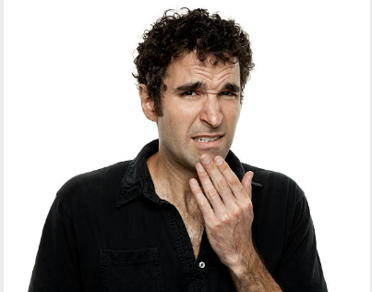
Changes in Marijuana Potency
Notes:
Parent #5 on camera:
“Is the marijuana kids are smoking today any different than the stuff I smoked when I was younger?”

Slide 19
Changes in Marijuana Potency
iStock photo ID:155217222
iStock photo ID:641201900
1 – 2% THC
20 – 30% THC
Notes:
VO: “Today’s marijuana is more potent than it was in the 1960s and 1970s. Potency has gone from 1 – 2% THC to 20 – 30% THC in smoked form, and up to 96% THC in butane hash oil extracts and oils used in edibles.”
Animate in the numbers “1 - 2%” and “20 – 30%” and “96%” in sync with the VO.

Slide 20
Did You Know…
Marijuana can cause the heart rate to increase
by 20 to 50 beats per minute.
iStock ID#619413554
Notes:
Short music motif intro.
VO: ”Did you know… Marijuana can cause the heart rate to increase by 20 to 50 beats per minute. This increase can last for hours after use has stopped.
Animate heart to “beat” slowly at first, then faster. (Include Heartbeat sound effects to match.)

Slide 21

Marijuana and the Law
Notes:
Parent #6 on camera:
“My son turns 18 this month. Will he be able to smoke marijuana legally once he does?”

Slide 22
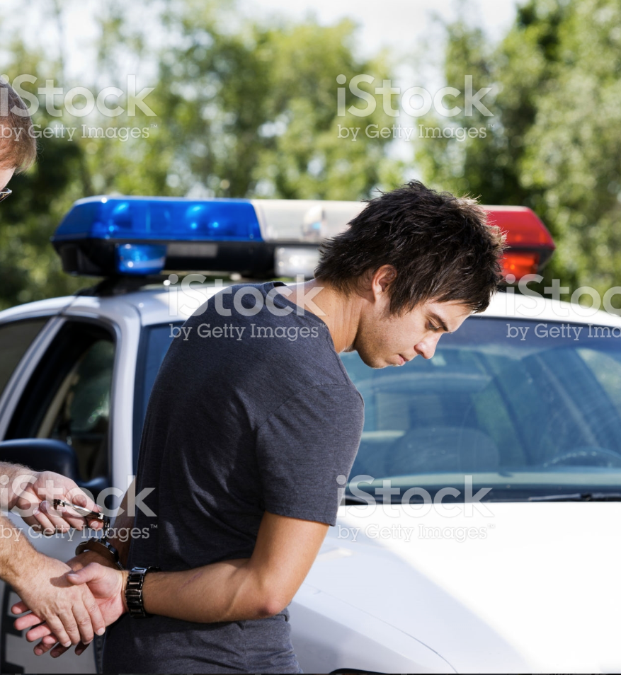
Marijuana and the Law
• must be 21 years old to use recreational marijuana
• prohibited anywhere tobacco smoking is prohibited
• illegal to drive under the influence of marijuana
• illegal to drive with an open container of marijuana
• illegal to sell marijuana outside of locally-approved and licensed dispensaries
iStock Photo #155147451
Notes:
VO: “Only adults 21 years and older can purchase and use marijuana recreationally.
Other important things to know about marijuana and California law include:
• Using recreational marijuana in California is prohibited anywhere tobacco smoking is prohibited
• It is illegal to drive under the influence or with an open container of marijuana
• It is illegal to sell marijuana outside of locally-approved and licensed dispensaries”

Slide 23

Prevention
Notes:
Parent #1 on camera:
“What can I do to make my daughter less likely to experiment with marijuana?”

Slide 24
Prevention
iStock ID #699251012
iStock ID #162368388
Notes:
VO: “Parents who talk with their kids about not using marijuana have teens who are less likely to use marijuana. You might be surprised at how much influence your words, actions and opinions can have on your child’s choices. Speak up and get the conversation started!”

Slide 25

Finding More Information
Notes:
Parent #7 on camera:
“Where can I find more information?”

Slide 26
Finding More Information
• www.drugabuse.gov
• www.smartcolorado.org
• www.justthinktwice.com
iStock ID #836051392
Notes:
VO: “More information on this topic can be found online by visiting www.drugabuse.gov, www.smartcolorado.org, and www.justthinktwice.com.”
Animate links on one at a time.

