Slide 1
Binge Drinking
20%
504460686
Notes:
VO: “Middle school and high school aged children are a growing area of concern for binge drinking. 20% of youth between the ages of 12 and 20 have engaged in binge drinking at some time over the past 30 days”
Programmer Notes: Animate a large 20% over image in sync with VO.

Slide 2

Binge Drinking
675250354
512217748
iStock #157194262
Girl: iStock #174627261
Boy Face: iStock #75404427
Notes:
VO: “Youth who binge drink are four times more likely to get into a serious fight, three times more likely to need medical emergency care, two times more likely to get into an accident and more likely to have unprotected sex. “
Question from Mike: For consistency, how much more likely to have unprotected sex? Twice as likely? Three times?

Slide 3
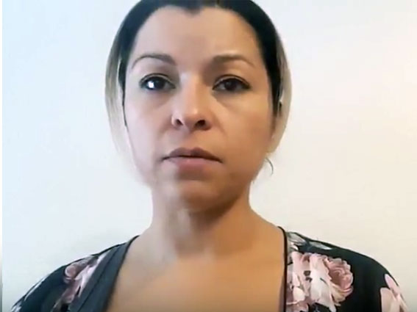
Warning Signs
Notes:
Parent on Camera: “What kind of warning signs should we be looking for?”

Slide 4

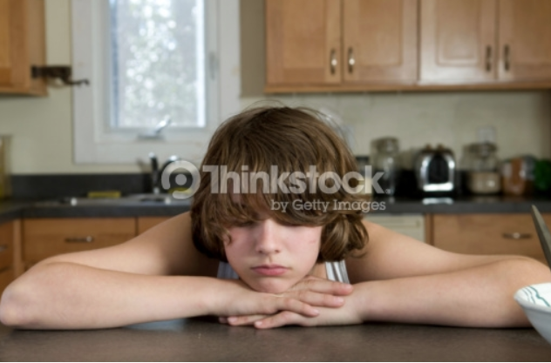
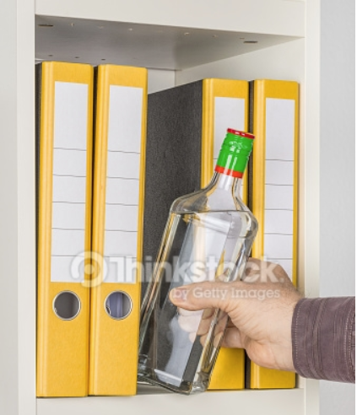

Warning Signs
Mood changes
School Problems
Rebelling
Switching friends
A “nothing matters” attitude
Finding alcohol
Physical or mental problems
Notes:
VO
“Parents should be vigilant and keep an eye out for signs of alcohol use that include:
Mood changes such as flare-ups of temper, increased irritability or defensiveness.
School issues such as poor attendance, low grades, or recent disciplinary actions.
Rebelling against family, school, or societal rules or authority figures.
Switching friends with a reluctance to have you get to know the new ones.
A “nothing matters” attitude such as sloppy appearance, a lack of involvement in former interests, and general low energy.
Finding alcohol in your child’s room or backpack, or smelling alcohol on his or her breath.
Physical or mental problems such as memory lapses, poor concentration, bloodshot eyes, lack of coordination, or slurred speech.”
Programmer Notes:
Images:
Thinkstock Moody: 147683845
Thinkstock School problems 867127210
Thinkstock Rebelling 607282924
ISTOCK Switching Friends 542963638
Thinkstock Nothing matters 97558690
Thinkstock Finding Alcohol 495054338
Thinkstock Physical Problems – 56569616 & 56569618

Slide 5
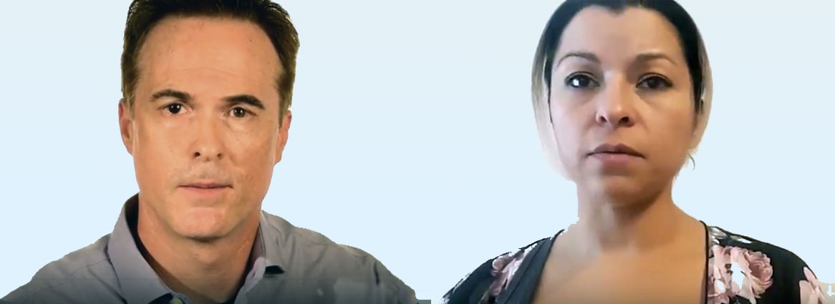
Prevention
Notes:
Parents on camera:
“As parents, what can we do to prevent our children from drinking? “

Slide 6
Prevention
Connect with your child
MAKE TIME
TALK ONE ON ONE
LISTEN
KNOW WHAT TO SAY
iStock #842699352
Notes:
VO: “Parents have the greatest influence on whether or not their children will drink alcohol. Make time to talk one on one with your child about drinking, and listen to what he or she has to say. Be prepared and know what to say to prevent drinking. “
Programming Notes: Fly words in in sync with VO.

Slide 7

Prevention
Develop Family Rules
No drinking until age 21
Older siblings help out
Leave any party if there is alcohol
No rides with a driver who’s been drinking
Discuss consequences
78631212
Notes:
VO: “Consider developing family rules about underage drinking such as:
• No drinking until they turn 21
• Older siblings should help out by encouraging younger siblings to abstain from drinking
• Leave any party if alcohol is served
• No riding in cars with a driver who has been drinking
Be sure to discuss the consequences they will face at home if they drink."
Programmer Notes: Text displays in sync with VO.

Slide 8
Prevention
Encourage healthier alternatives
iStock #545361158
ThinkStock #873590486
iStock #827810230
Notes:
VO: “Parents should encourage healthier alternatives to drinking out of boredom. Get kids engaged in sports, hobbies, games, concerts, movies, working or volunteering. “
Programmer Notes: Introduce images in sync with VO

Slide 9
Prevention
Keep tabs on your kids
ThinkStock #531416356
ThinkStock #476345559
Notes:
VO: “Another approach is to keep track of your children’s activities. Be aware of what they are doing and who they are doing it with. When your child returns from going out, be sure to make contact, ask questions and listen.”

Slide 10
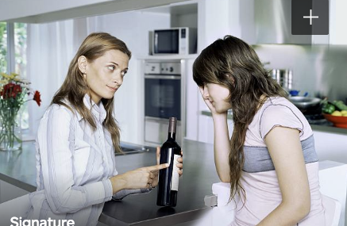
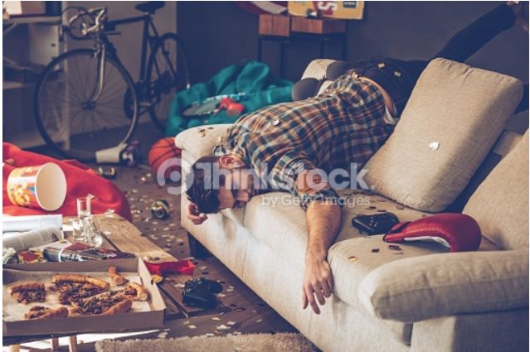
Prevention
Set firm expectations
Mom: iStock #79122854
Daughter: iStock #79122796
ThinkStock #516683364
Notes:
VO: “Don’t allow underage drinking in your home. Be clear with your child about the rules. If you are going to be away, pre-arrange for a neighbor to check-in. Permit the neighbor to call the police to shut down a party if things get out of control. Tell your teen you have arranged this beforehand. “

Slide 11

Prevention
Set a good example.
Think stock 119860944
iStock #184980147
Notes:
VO: “Kids watch what their parents do. Set a good example by limiting your use of alcohol in the home. “

Slide 12
Binge Drinking
Notes:
Parents on camera:
“Where can we find more information?”

Slide 13
Finding More Information
www.Sacramentoccy.org
ThinkStock #836051392
Notes:
VO: “More information on teens and alcohol abuse can be found online by visiting www.Sacramentoccy.org”

