Slide 1

A Parent’s Survival Guide to Adolescent Alcohol Use
Notes:
VO: A Parent’s Survival Guide to Adolescent Alcohol Use

Slide 2
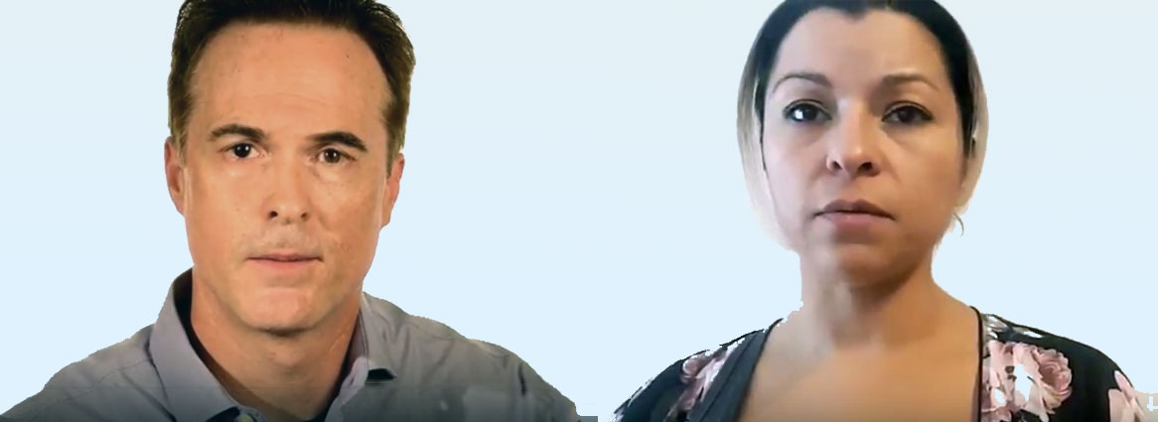
Why?
Notes:
Parents on camera. Setting: family home, living room.
Mother: “We’re concerned about our teenage children and alcohol use.”
Father: “Why are so many kids drinking at such a young age?”

Slide 3
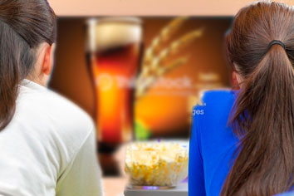
Why do kids drink?
844386700
501846194
Boredom
Social Pressure
Individual Stressors
Easy Access at Home
Mass Marketing
Kids: 530926156
500020195
Beer: 827896338
Notes:
VO
“The number one reason people begin drinking at a young age is boredom. After boredom, the next most common reason is social pressure – wanting to fit in. For some it can be Individual stressors. Another instigator is easy access to alcohol at home. Teens are also bombarded with mass marketing of alcohol on TV, social media, billboards, etc.
Programming Notes: Images and words appear in time with the VO.

Slide 4
Did You Know…
Bad Decisions
Slowed Senses
Impaired Learning and Memory
Impairment of Basic Functions
iStock ID# 182410808
Notes:
VO:
”Did you know…
The brain of a teenager is undergoing the biggest stage of growth it’s experienced since toddler age Adding alcohol to the brain during this stage of development can be devastating, resulting in:
Bad Decisions
Slowed Senses
Impaired Learning and Memory
Impairment of Basic Functions “
Programming Notes: Puzzle pieces fade away and text appears onscreen as symptoms are described

Slide 5
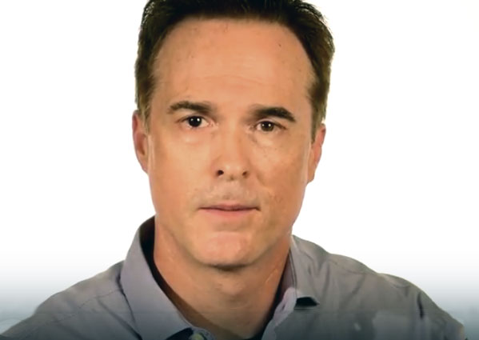
What’s Changed…?
Notes:
Father on camera:
“Is drinking today any different from when I was younger?”

Slide 6
Trends
37%
11th grade
41%
9th grade
26%
7th grade
Thinkstock #180904062
Notes:
VO:
“Studies show that young people are experimenting with alcohol at earlier ages more than ever before.
• 37% start drinking in the 11th grade.
41% start drinking in the 9th grade and
26% start drinking in the 7th grade. “
MIKE ASKS: CAN WE DOUBLE-CHECK THESE STATS? PERCENTAGES TOTAL 104%
Programming Notes:
Page loads with images of kids. The list of stats build, showing percentage first then associated grade.

Slide 7

Trends
876641692
Teen: #493659212
Bottle: #537548172
166842815
Bridge: #519163440
169276532
Notes:
VO: “Sacramento Youth are consuming alcohol more than any other drug, drinking regularly and imbibing dangerous quantities in one sitting.
Though it may seem that drugs like opioids and marijuana are used more frequently, alcohol is being used by more Sacramento County teens than all other drugs… _combined_. “
Programming Notes:
Page loads with silhouette of teen on the Tower Bridge. Dissolve to images of opioids and marijuana. Large image of alcohol zooms in to obscure the smaller photos of other dugs.

Slide 8
Did You Know…
200,000 ER Visits
4,300 Deaths
AA043359
184345990
Notes:
(Sound effect of siren)
VO: “Did you know…
Teen alcohol abuse is responsible for nearly 200,000 ER visits and 4,300 deaths among kids all under the age of 21."

Slide 9
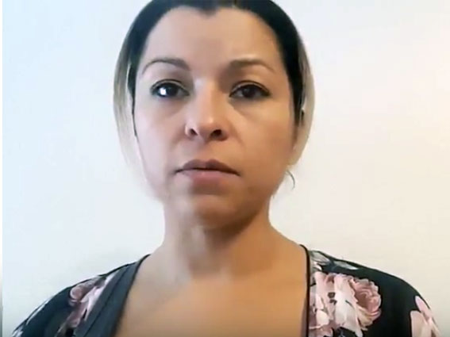
Dependence
Notes:
Parent on camera:
“Does it matter how old a person is the first time they get drunk?“

Slide 10
Dependence
RISKS
Becoming a Heavier Drinker
Addiction
Cognitive Issues
Health Problems
907965598
Notes:
VO
“Studies show that teens who have their first experience being drunk before the age of 18 had a much greater chance of becoming a heavier drinker, developing an addiction, and having cognitive issues or health problems as an adult. “
Programmer Notes:
List of risks appear in sync with VO.

Slide 11
Dependence
Addiction
Cognitive Issues
Health Problems
Animation of calendar pages flipping by years
825596504
Notes:
VO
“Parents should know that for every year you can delay the start of your child’s drinking, you greatly reduce their risk of addiction, cognitive issues and health problems.“
Programmer Notes:
Animation of calendar pages flipping, text slowly shrinks to nothing as time progresses.
(Note to Mike: See your “Red Flags” Citizenship video)

Slide 12
Binge Drinking
Notes:
Parents on camera.
Father: “We’re hearing a lot about ‘Binge Drinking’ on the news these days.”
Mother: “What exactly is ‘Binge Drinking’?”

Slide 13


Binge Drinking
iStock# 841357766
Mike has silhouette treatment
ThinkStock #492456096
Notes:
VO: “The term ‘Binge Drinking’ refers to the consumption of alcohol in a short period of time, bringing the blood alcohol level concentration (BAC) to 0.08 or above. Studies show that 1 in 7 teenagers binge drink, often resulting in harmful consequences. ”
Programmer Notes: Start off with image of bottles and shadow. Animate in seven silhouettes to represent teenagers.

