Slide 1

A Parent’s Survival Guide to
Adolescent Alcohol Use
Notes:
VO: A Parent’s Survival Guide to Adolescent Alcohol Use

Slide 2
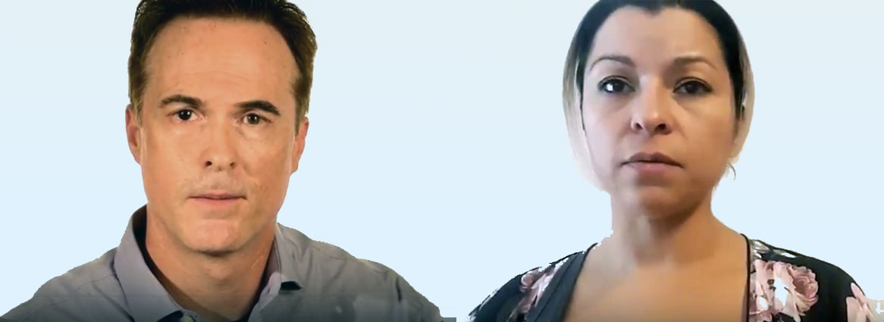
Why?
Notes:
Parents on camera. Setting: family home, living room.
Mother: “We’re concerned about our teenage children and alcohol use.”
Father: “Why are so many kids drinking at such a young age?”

Slide 3
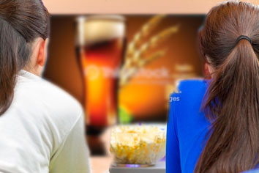
Why do kids drink?
844386700
501846194
Boredom
Social Pressure
Individual Stressors
Easy Access at Home
Mass Marketing
Kids: 530926156
500020195
Beer: 827896338
Notes:
VO
“The number one reason people begin drinking at a young age is boredom. After boredom, the next most common reason is social pressure – wanting to fit in. For some it can be Individual stressors. Another instigator is easy access to alcohol at home. Teens are also bombarded with mass marketing of alcohol on TV, social media, billboards, etc.
Programming Notes: Images and words appear in time with the VO.

Slide 4
Did You Know…
Bad Decisions
Slowed Senses
Impaired Learning and Memory
Impairment of Basic Functions
iStock ID# 182410808
Notes:
VO:
”Did you know…
The brain of a teenager is undergoing the biggest stage of growth it’s experienced since toddler age Adding alcohol to the brain during this stage of development can be devastating, resulting in:
Bad Decisions
Slowed Senses
Impaired Learning and Memory
Impairment of Basic Functions “
Programming Notes: Puzzle pieces fade away and text appears onscreen as symptoms are described

Slide 5
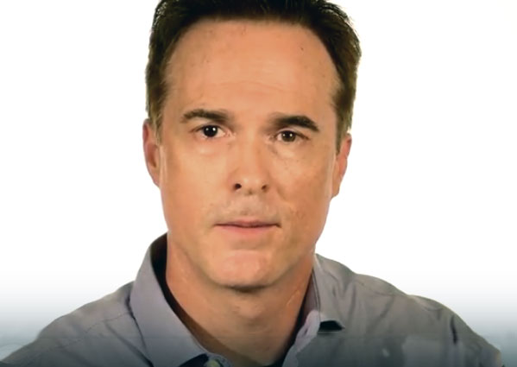
What’s Changed…?
Notes:
Father on camera:
“Is drinking today any different from when I was younger?”

Slide 6
Trends
37%
11th grade
41%
9th grade
26%
7th grade
Thinkstock #180904062
Notes:
VO:
“Studies show that young people are experimenting with alcohol at earlier ages more than ever before.
• 37% start drinking in the 11th grade.
41% start drinking in the 9th grade and
26% start drinking in the 7th grade. “
MIKE ASKS: CAN WE DOUBLE-CHECK THESE STATS? PERCENTAGES TOTAL 104%
Programming Notes:
Page loads with images of kids. The list of stats build, showing percentage first then associated grade.

Slide 7

Trends
876641692
Teen: #493659212
Bottle: #537548172
166842815
Bridge: #519163440
169276532
Notes:
VO: “Sacramento Youth are consuming alcohol more than any other drug, drinking regularly and imbibing dangerous quantities in one sitting.
Though it may seem that drugs like opioids and marijuana are used more frequently, alcohol is being used by more Sacramento County teens than all other drugs… _combined_. “
Programming Notes:
Page loads with silhouette of teen on the Tower Bridge. Dissolve to images of opioids and marijuana. Large image of alcohol zooms in to obscure the smaller photos of other dugs.

Slide 8
Did You Know…
200,000 ER Visits
4,300 Deaths
AA043359
184345990
Notes:
(Sound effect of siren)
VO: “Did you know…
Teen alcohol abuse is responsible for nearly 200,000 ER visits and 4,300 deaths among kids all under the age of 21."

Slide 9
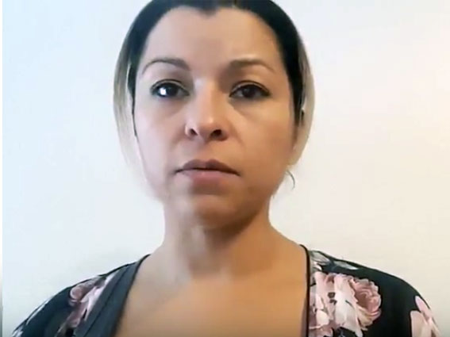
Dependence
Notes:
Parent on camera:
“Does it matter how old a person is the first time they get drunk?“

Slide 10
Dependence
RISKS
Becoming a Heavier Drinker
Addiction
Cognitive Issues
Health Problems
907965598
Notes:
VO
“Studies show that teens who have their first experience being drunk before the age of 18 had a much greater chance of becoming a heavier drinker, developing an addiction, and having cognitive issues or health problems as an adult. “
Programmer Notes:
List of risks appear in sync with VO.

Slide 11
Dependence
Addiction
Cognitive Issues
Health Problems
Animation of calendar pages flipping by years
825596504
Notes:
VO
“Parents should know that for every year you can delay the start of your child’s drinking, you greatly reduce their risk of addiction, cognitive issues and health problems.“
Programmer Notes:
Animation of calendar pages flipping, text slowly shrinks to nothing as time progresses.
(Note to Mike: See your “Red Flags” Citizenship video)

Slide 12
Binge Drinking
Notes:
Parents on camera.
Father: “We’re hearing a lot about ‘Binge Drinking’ on the news these days.”
Mother: “What exactly is ‘Binge Drinking’?”

Slide 13


Binge Drinking
iStock# 841357766
Mike has silhouette treatment
ThinkStock #492456096
Notes:
VO: “The term ‘Binge Drinking’ refers to the consumption of alcohol in a short period of time, bringing the blood alcohol level concentration (BAC) to 0.08 or above. Studies show that 1 in 7 teenagers binge drink, often resulting in harmful consequences. ”
Programmer Notes: Start off with image of bottles and shadow. Animate in seven silhouettes to represent teenagers.

Slide 14
Binge Drinking
20%
504460686
Notes:
VO: “Middle school and high school aged children are a growing area of concern for binge drinking. 20% of youth between the ages of 12 and 20 have engaged in binge drinking at some time over the past 30 days”
Programmer Notes: Animate a large 20% over image in sync with VO.

Slide 15
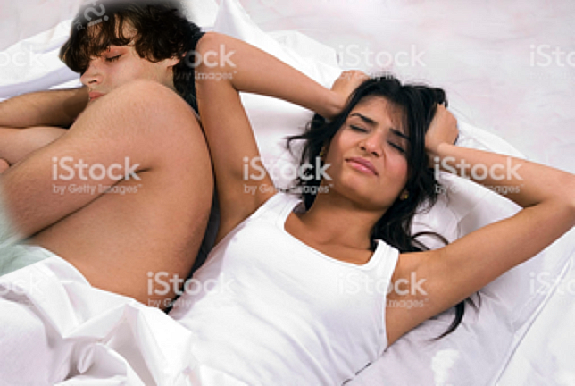
Binge Drinking
675250354
512217748
iStock #157194262
Girl: iStock #174627261
Boy Face: iStock #75404427
Notes:
VO: “Youth who binge drink are four times more likely to get into a serious fight, three times more likely to need medical emergency care, two times more likely to get into an accident and more likely to have unprotected sex. “
Question from Mike: For consistency, how much more likely to have unprotected sex? Twice as likely? Three times?

Slide 16
Warning Signs
Notes:
Parent on Camera: “What kind of warning signs should we be looking for?”

Slide 17

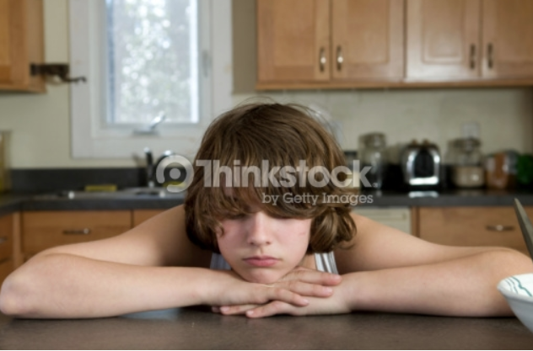
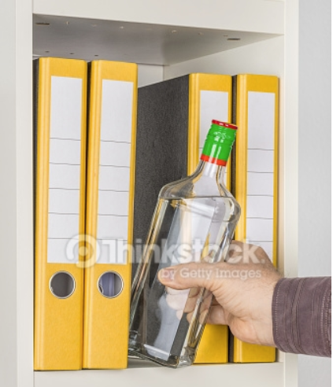

Warning Signs
Mood changes
School Problems
Rebelling
Switching friends
A “nothing matters” attitude
Finding alcohol
Physical or mental problems
Notes:
VO
“Parents should be vigilant and keep an eye out for signs of alcohol use that include:
Mood changes such as flare-ups of temper, increased irritability or defensiveness.
School issues such as poor attendance, low grades, or recent disciplinary actions.
Rebelling against family, school, or societal rules or authority figures.
Switching friends with a reluctance to have you get to know the new ones.
A “nothing matters” attitude such as sloppy appearance, a lack of involvement in former interests, and general low energy.
Finding alcohol in your child’s room or backpack, or smelling alcohol on his or her breath.
Physical or mental problems such as memory lapses, poor concentration, bloodshot eyes, lack of coordination, or slurred speech.”
Programmer Notes:
Images:
Thinkstock Moody: 147683845
Thinkstock School problems 867127210
Thinkstock Rebelling 607282924
ISTOCK Switching Friends 542963638
Thinkstock Nothing matters 97558690
Thinkstock Finding Alcohol 495054338
Thinkstock Physical Problems – 56569616 & 56569618

Slide 18
Prevention
Notes:
Parents on camera:
“As parents, what can we do to prevent our children from drinking? “

Slide 19
Prevention
Connect with your child
MAKE TIME
  TALK ONE ON ONE
LISTEN
KNOW WHAT TO SAY
iStock #842699352
Notes:
VO: “Parents have the greatest influence on whether or not their children will drink alcohol. Make time to talk one on one with your child about drinking, and listen to what he or she has to say. Be prepared and know what to say to prevent drinking. “
Programming Notes: Fly words in in sync with VO.

Slide 20
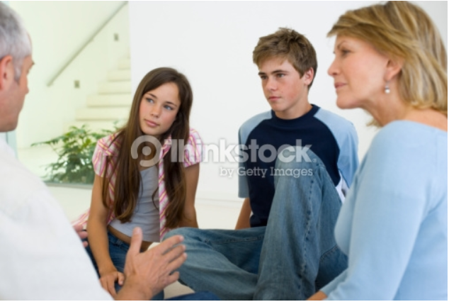
Prevention
Develop Family Rules
No drinking until age 21
Older siblings help out
Leave any party if there is alcohol
No rides with a driver who’s been drinking
Discuss consequences
78631212
Notes:
VO: “Consider developing family rules about underage drinking such as:
• No drinking until they turn 21
• Older siblings should help out by encouraging younger siblings to abstain from drinking
• Leave any party if alcohol is served
• No riding in cars with a driver who has been drinking
Be sure to discuss the consequences they will face at home if they drink."
Programmer Notes: Text displays in sync with VO.

Slide 21
Prevention
Encourage healthier alternatives
iStock #545361158
ThinkStock #873590486
iStock #827810230
Notes:
VO: “Parents should encourage healthier alternatives to drinking out of boredom. Get kids engaged in sports, hobbies, games, concerts, movies, working or volunteering. “
Programmer Notes: Introduce images in sync with VO

Slide 22
Prevention
Keep tabs on your kids
ThinkStock #531416356
ThinkStock #476345559
Notes:
VO: “Another approach is to keep track of your children’s activities. Be aware of what they are doing and who they are doing it with. When your child returns from going out, be sure to make contact, ask questions and listen.”

Slide 23
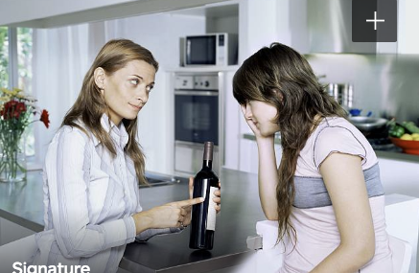
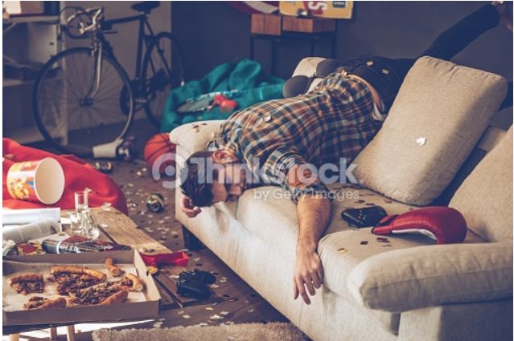
Prevention
Set firm expectations
Mom: iStock #79122854
Daughter: iStock #79122796
ThinkStock #516683364
Notes:
VO: “Don’t allow underage drinking in your home. Be clear with your child about the rules. If you are going to be away, pre-arrange for a neighbor to check-in. Permit the neighbor to call the police to shut down a party if things get out of control. Tell your teen you have arranged this beforehand. “

Slide 24

Prevention
Set a good example.
Think stock 119860944
iStock #184980147
Notes:
VO: “Kids watch what their parents do. Set a good example by limiting your use of alcohol in the home. “

Slide 25
Binge Drinking
Notes:
Parents on camera:
“Where can we find more information?”

Slide 26
Finding More Information
www.Sacramentoccy.org
ThinkStock #836051392
Notes:
VO: “More information on teens and alcohol abuse can be found online by visiting www.Sacramentoccy.org”

