Slide 1
Marijuana
What You Need To Know

Slide 2
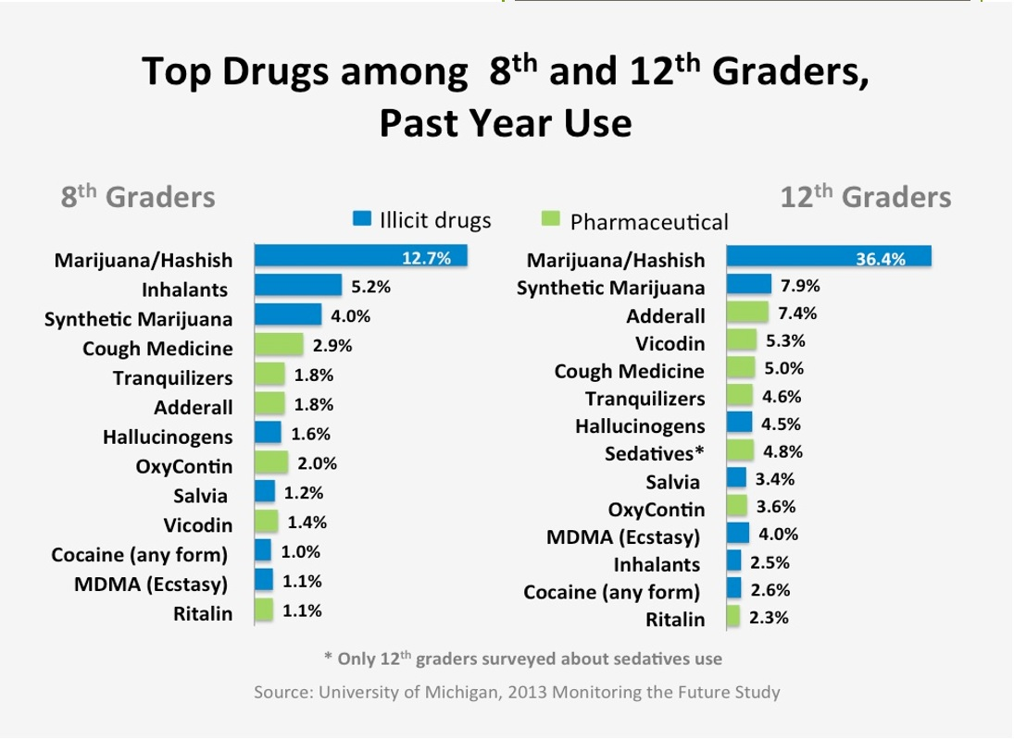
Usage Rates
Why are we talking about marijuana? After alcohol & tobacco, marijuana is the most commonly used drug
among middle and high school students.
Notes:
Why are we talking about marijuana? After alcohol & tobacco, marijuana is the most commonly used drug among middle and high school students.

Slide 3
Usage Rates
For some, age groups, marijuana use exceeds cigarette use.
A Monitoring the Future National Survey Results on Drug Use, 2016 showed:
  Nationally, among high school students in 2015, marijuana use exceeded cigarette use;
  21.3 % of high school seniors reported using marijuana in the past 30 days, compared with 11.4 % who smoked cigarettes .

Slide 4
Local Usage Rates
In California, reported use of marijuana in the last 30 days from 2013-2015:
  5% of 7th graders
  13.4 % of 9th graders
  22 % of 11th graders

Slide 5
Local Usage Rates
With recent legalization, the number in California could rise.
Studies show that usage rates for those 12 years and over increase with legalization.

Slide 6
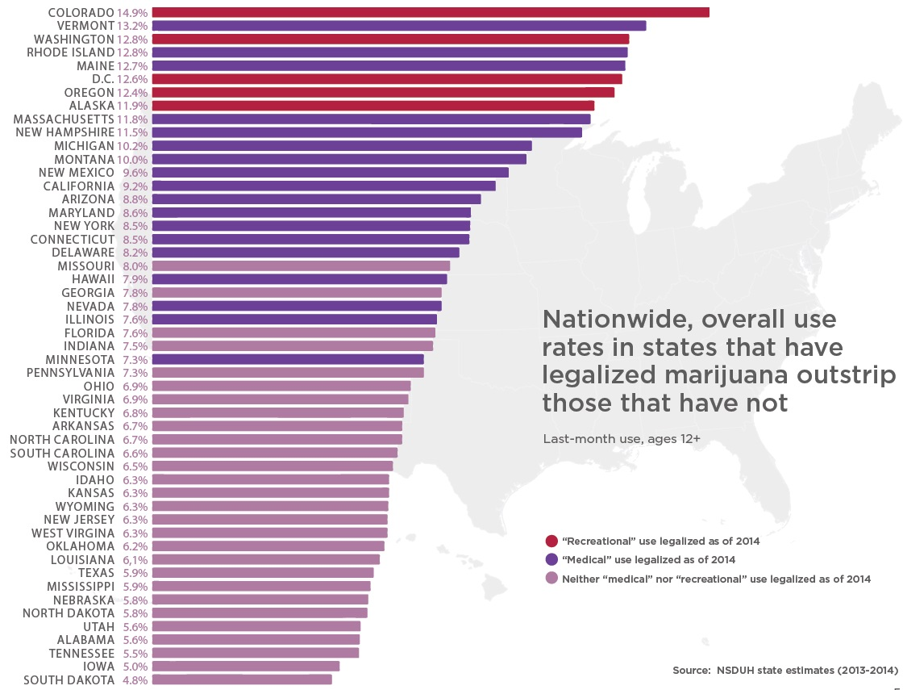
If It’s Legal, Use Goes Up

Slide 7
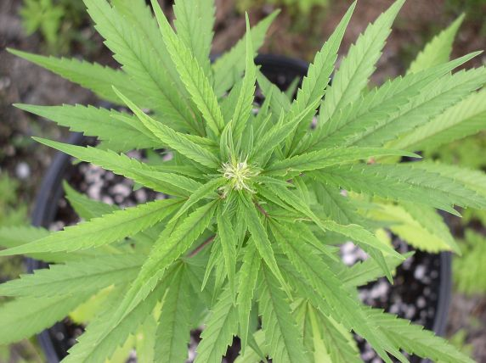
Is There A Difference Between Marijuana & Cannabis?
Short answer : there is no difference.
The word “marijuana” is slang used to describe the drug derived from the cannabis plant.
The word “marijuana” is used so frequently the words marijuana and cannabis are often used interchangeably.
It is a green, brown, or gray mixture of dried, shredded leaves, stems, seeds, and flowers of the cannabis satavia plant.

Slide 8
Chemicals in Marijuana
There are over 400 different chemicals in marijuana.
This includes over 100 cannabinoids that can have different biological effects.
Two primary cannabinoids are:
  (THC) delta-9 tetrahydrocannabinol
  (CBD) cannabidiol
THC is marijuana’s main psychoactive ingredient which causes an intoxicating high and euphoria.
CBD does not produce a high and is not intoxicating.
CBD is being tested for its effectiveness as a medicine

Slide 9
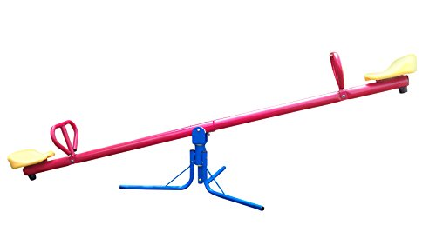
The CBD & THC See-Saw
If the content of one is high, the other is low, and which cannabinoid has the highest concentration depends on what the plant is grown to produce.
The more high you feel, the less medicinal value it has.

Slide 10
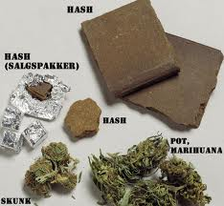
Common Forms
Hashish’ (or ‘hash’) is the pure resin separated and collected from the flowering tops of the cannabis plant
Depending on purity it varies in color from golden brown to black - it can be smoked, eaten or vaporized

Slide 11
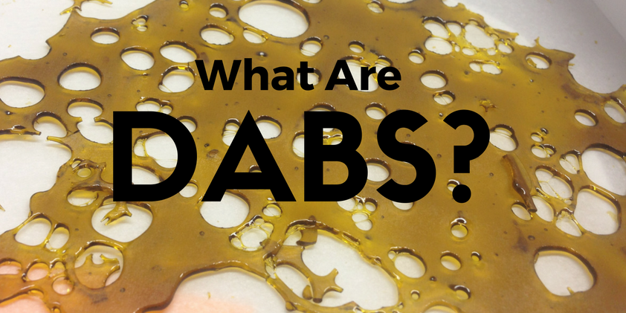
Common Forms
Dabs are a type of marijuana concentrate.

Slide 12
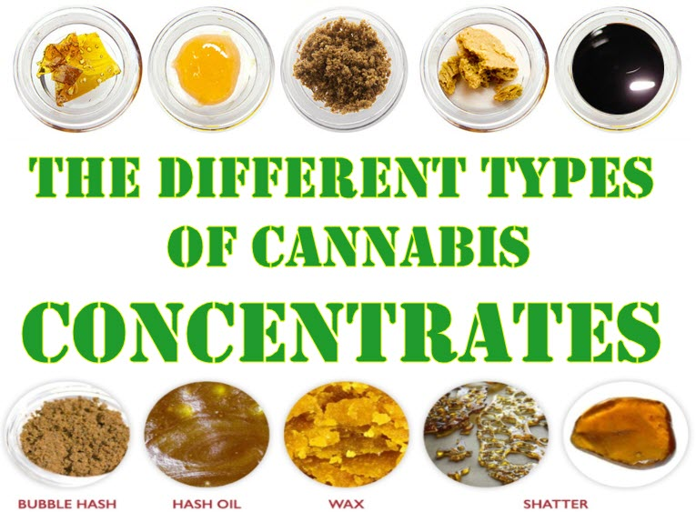
Forms - Dabs / Oils
Other Forms

Slide 13
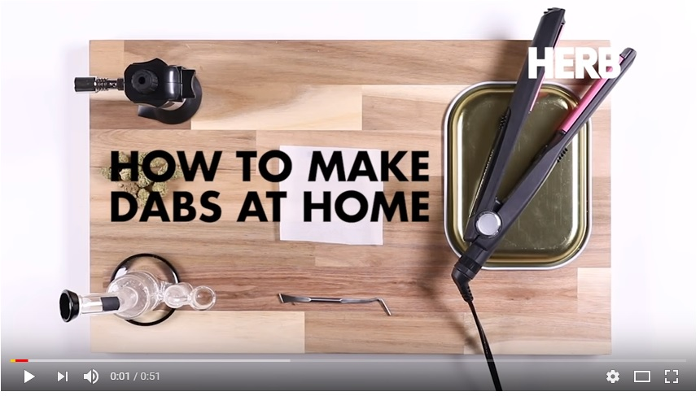
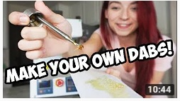
Forms - Dabs / Oils
Dabs are concentrated doses of cannabis that are made by extracting THC and other cannabinoids using a solvent like butane or carbon dioxide, resulting in sticky oils also commonly referred to as wax, shatter, budder, and butane hash oil (BHO).

Slide 14

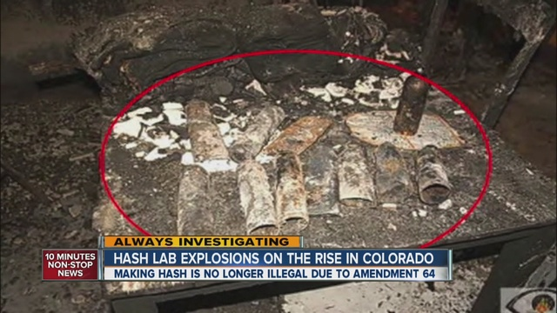
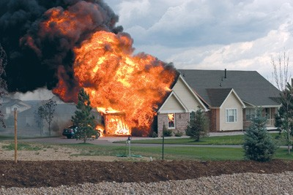
Forms - Dabs / Oils
Similar methods are used in the production of methamphetamine, cocaine and crack.
There are over 9,000 videos online
showing how to make dabs.
32 DIE FROM CALIFORNIA BHO LAB FIRES IN 2014

Slide 15

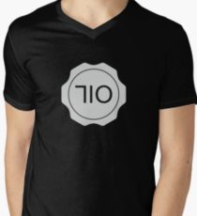
Forms - Dabs / Oils
They’re heated on a hot surface, usually a nail, and then inhaled through a dab rig.
More advanced extraction methods have led to a flood of cannabis concentrates that have boosted dabbing’s popularity.
“710” products advertise
dabs / oils.
“710” flipped upside down spells “OIL”

Slide 16
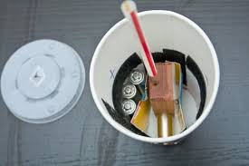
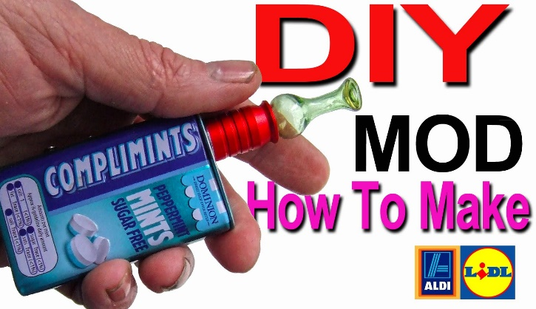


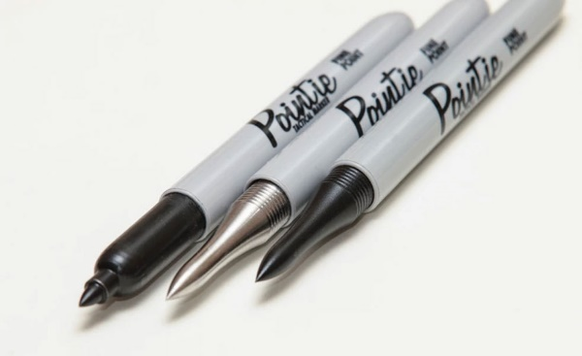
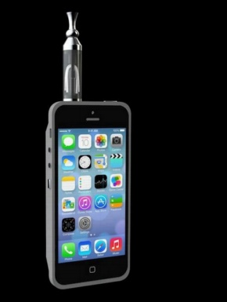
Forms - Dabs / Oils
Vape pens are used to smoke “dabs” and give the appearance of a pen or electronic cigarette. They do not produce smoke or any odor.

Slide 17
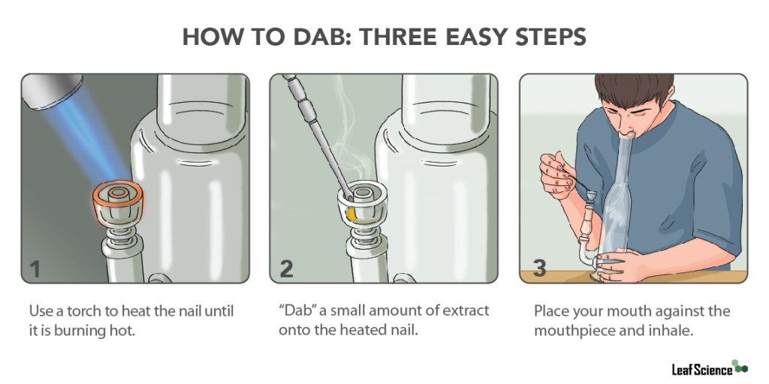
Forms - Dabs / Oils
The typical joint is 11 to 21 percent THC
A dab may contain 70% to 90% of THC. Users may have a high that lasts up to 24 hours
There are thousands of sites online that teach how to smoke dabs.

Slide 18
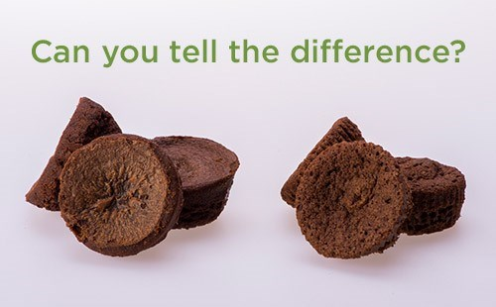
Forms - Edibles
Edibles are food products infused with marijuana. Though smoking marijuana is the most prevalent method of consumption, eating marijuana is quickly becoming a popular way to consume the drug.
Brownies are among the most common food products infused with marijuana, however, almost any food product may be infused with marijuana and eaten.

Slide 19
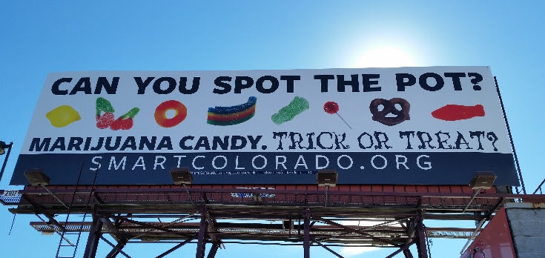
Forms - Edibles
In addition to placing marijuana directly in food, marijuana-infused cooking oil can be used when frying or searing food, and marijuana-infused butter can be spread or sprayed directly on prepared food.
These marijuana edibles are more common in states that have legalized marijuana and also states that permit medical marijuana use.

Slide 20
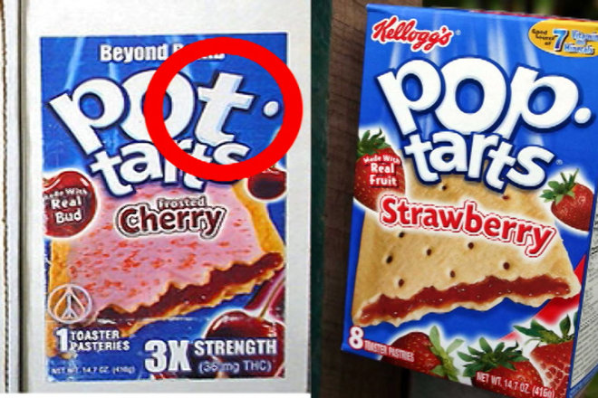
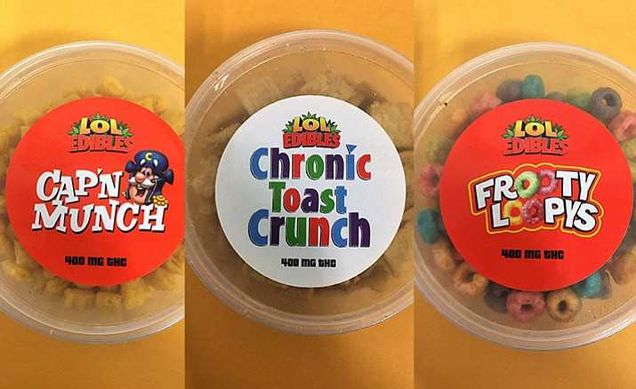
Forms - Edibles
The effects from smoking marijuana only takes minutes. Edibles, however, take between 1-3 hours because food is absorbed into the bloodstream through the liver.
Because it takes longer, the user may end up consuming larger amounts of the drug while thinking the drug isn't working.

Slide 21
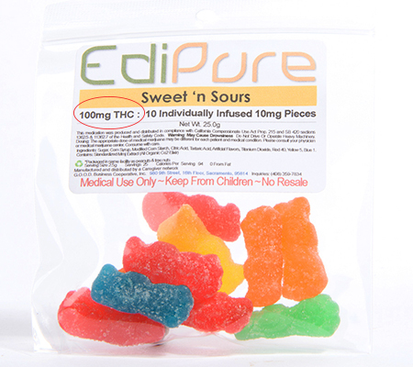
Forms - Edibles
The amount of THC, the active ingredient in marijuana, is very difficult to measure and is often unknown in these food products.
Generally 1mg = 1 dose
This small bag of gummy bears contains
100 “doses” of THC

Slide 22
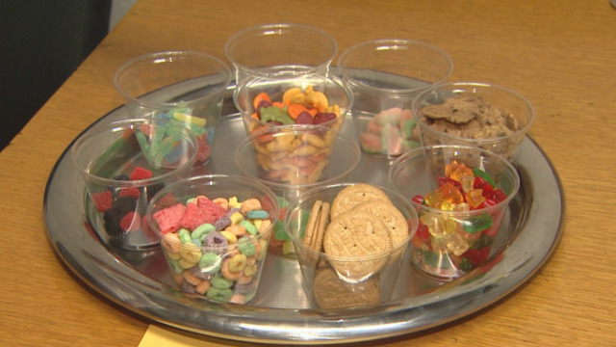
Forms - Edibles
If the user has other medications in his or her system, their body may metabolize different amounts of THC, causing THC levels in the bloodstream to dangerously increase five-fold.
Overdose symptoms from eating marijuana are often more severe than symptoms of an overdose from smoking marijuana.

Slide 23
Forms - Edibles
985 calls to US poison centers in children ages
9 and younger between 2005 and 2011
Rate of calls in states that passed legislation legalizing marijuana use (recreational or medicinal purposes) before 2005 increased from 3.9 calls per 100,000 population in 2005 to 14.8 calls per 100,000 population in 2011
Rate of calls in states that did not pass legislation saw no change in the rate of poison center calls

Slide 24
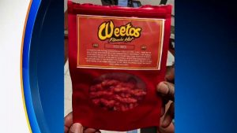
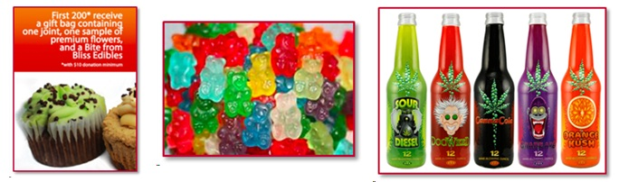
Forms - Edibles
Among 12th graders who used marijuana
in the past year,
40 % reported having consumed it in edible form in “legal” marijuana states,
versus 26% in “illegal” marijuana states.
(Source: NIDA, 2014 Monitoring the Future Study)

Slide 25
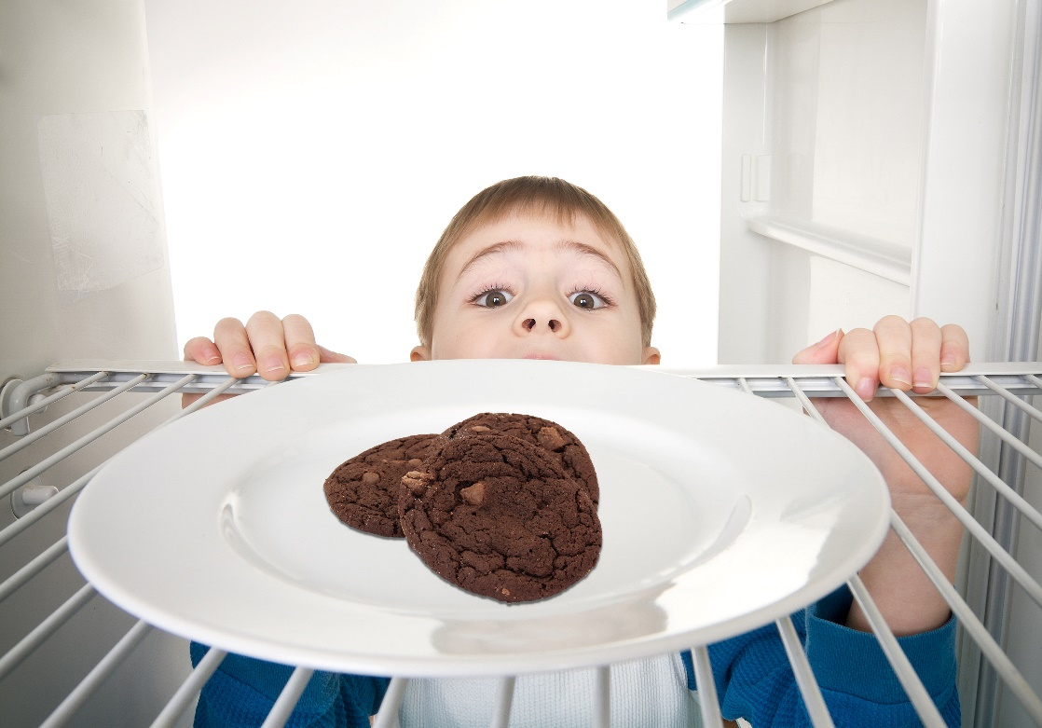
Forms - Edibles
Kids’ emergency room visits for marijuana increased in Colorado after legalization.
Edibles account for nearly half of accidental exposures.

Slide 26
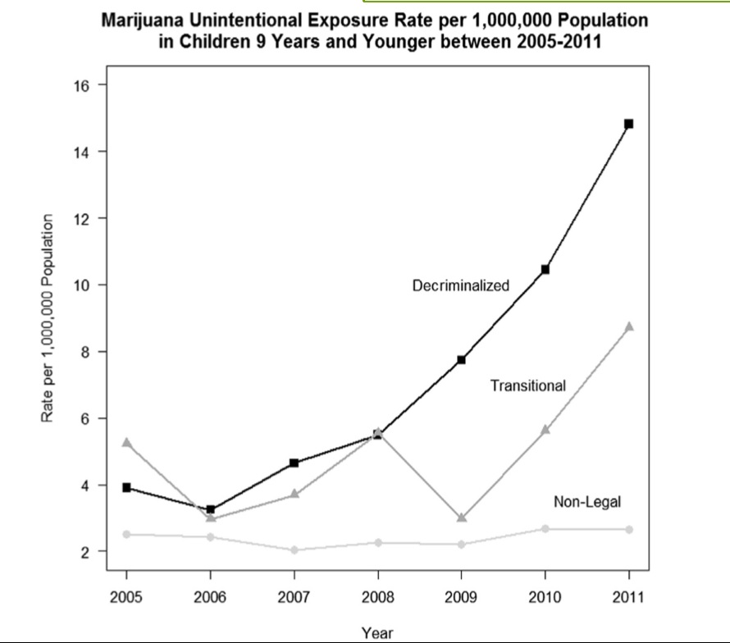
Forms - Edibles
Unintentional Pediatric Marijuana Exposures
Source: CESAR Fax March 3, 2014. Vol. 23, Issue 8

Slide 27
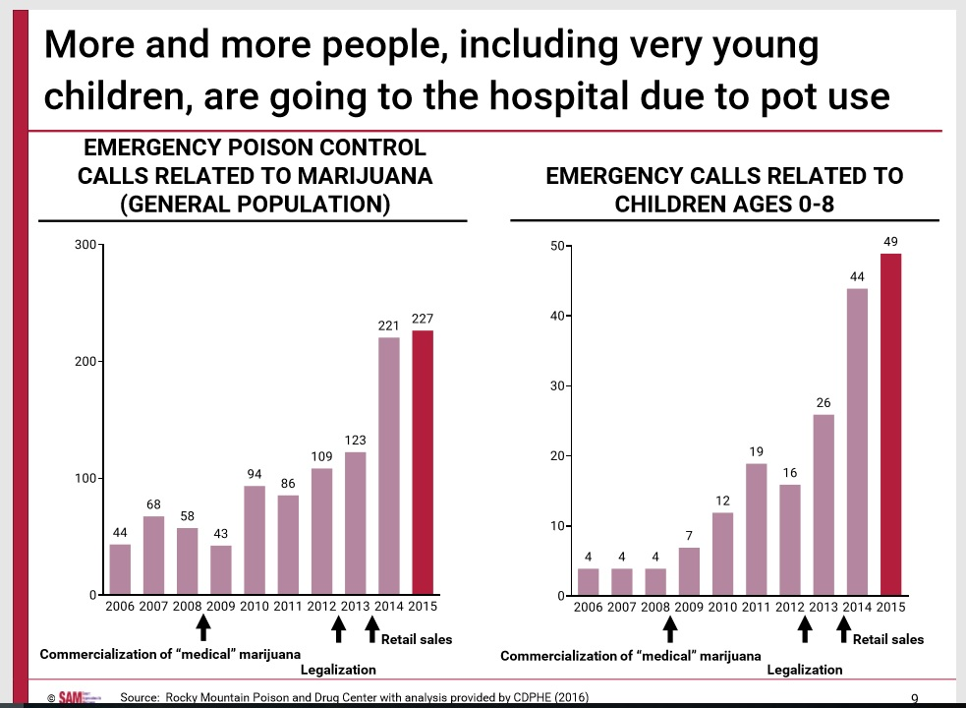
Forms - Edibles
Unintentional Pediatric Marijuana Exposures

Slide 28
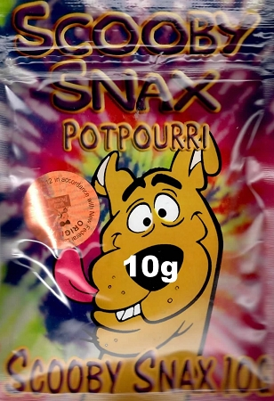
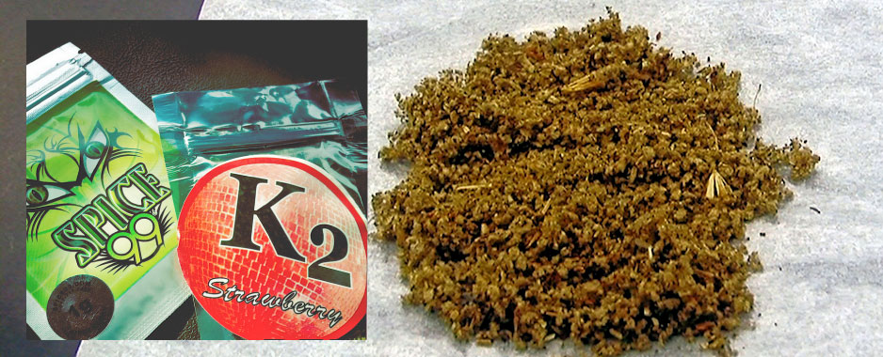
Forms - Synthetics
Mixture of herbs and spices sprayed with a synthetic compound chemically made to mimic to THC.
No part of synthetics come from the cannabis plant.
K2 or spice = a synthetic cannabinoid.

Slide 29
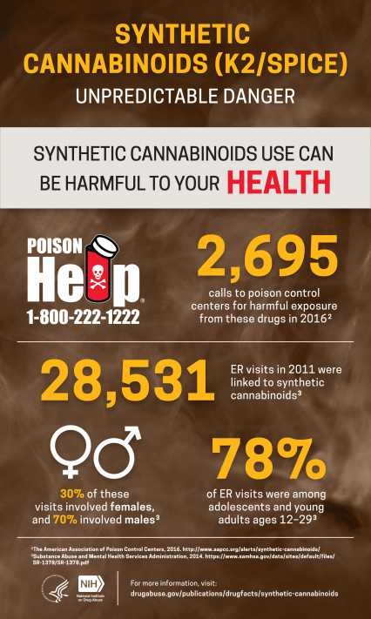
Forms - Synthetics
Some people think that smoking synthetics is a safe way to “fit in” to the marijuana culture.
In reality synthetics are VERY dangerous.

Slide 30
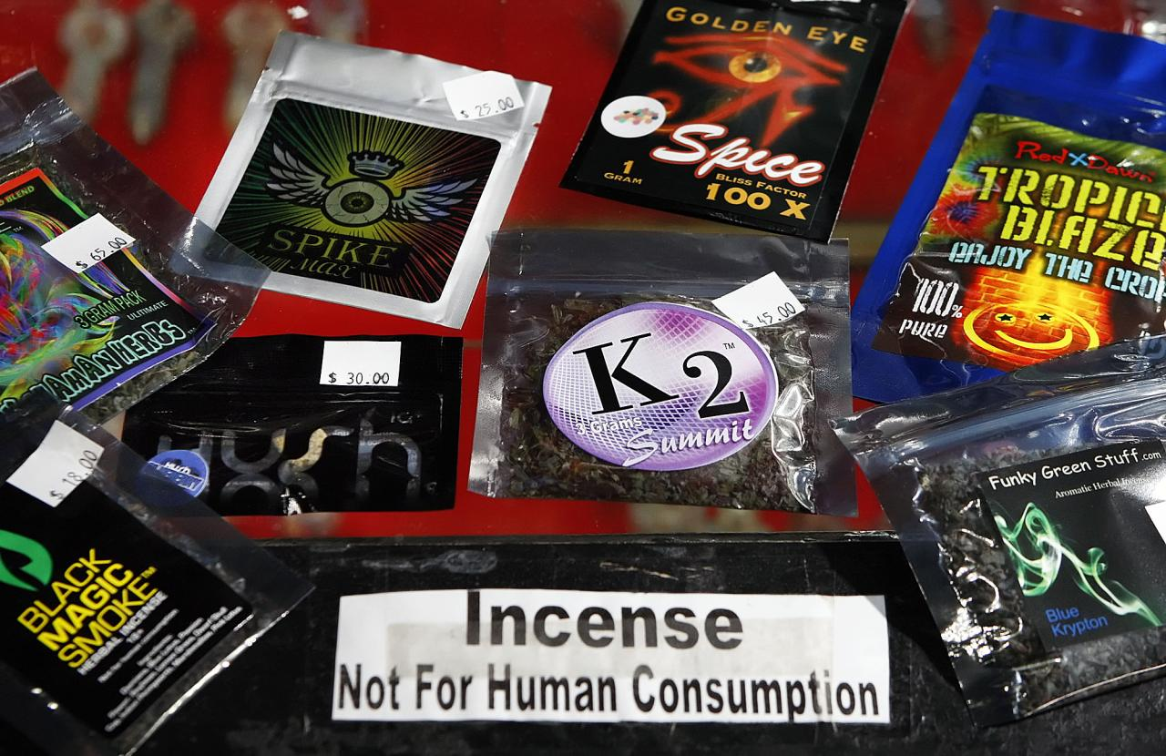
Forms - Synthetics
Dangerous because toxicity of the components can vary and be unknown.
Because it is labeled “Not For Human Consumption” and is marketed as an incense type product the FDA can not regulate it nor make it illegal.
It addition to being smoked it can be added to food and drinks.

Slide 31
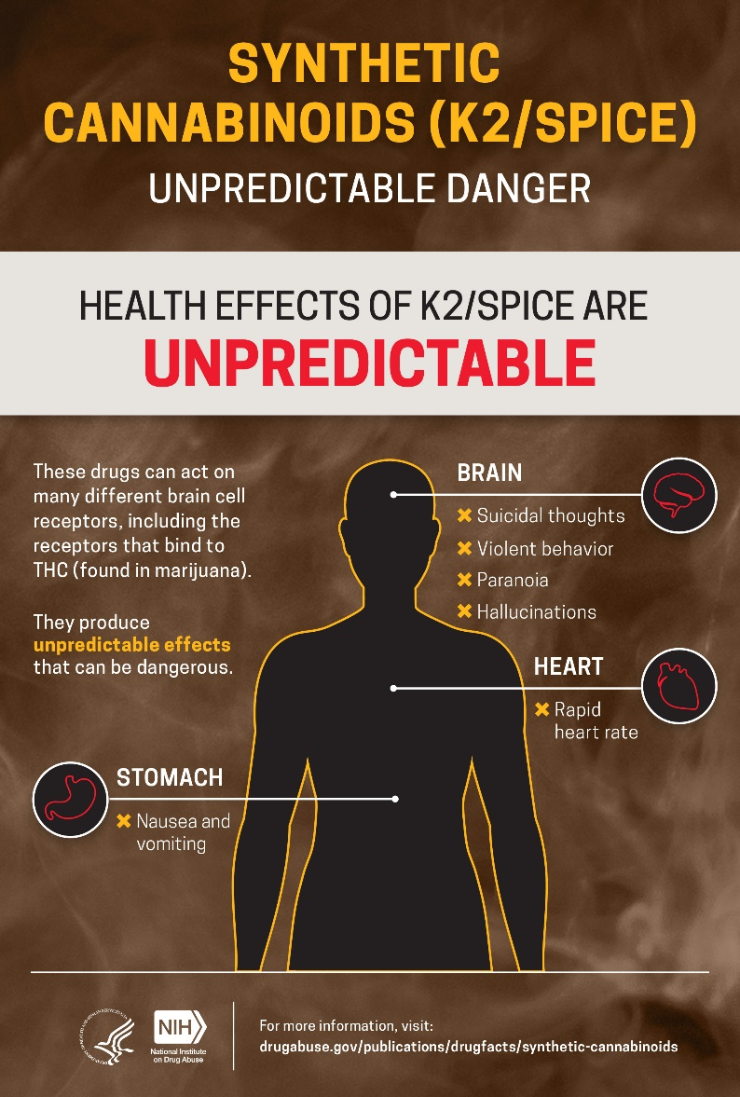
Forms - Synthetics
Side effects of Spice can include:
Hallucinations
Vomiting
Confusion and Paranoia
Rapid heart rate
Myocardial Ischemia
Heart Attack
Psychotic and Violent Behavior
Renal Failure
Anxiety
Tremor
Seizures
Loss of Consciousness
High Blood Pressure
Death

Slide 32
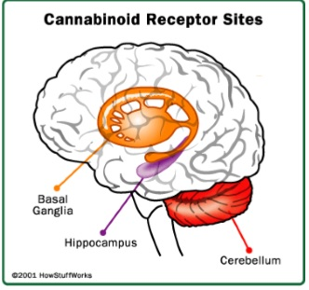
The Effects
THC affects the (cannabinoid receptors) parts of the brain that influence pleasure, memory, thinking, sensory, time perception, coordinated movement and concentration
A “high” is produced when these parts of the brain are overstimulated
The effects of THC causes:
Memory problems
Problems with processing information
Poor sensory & time perception
Poor concentration & coordination

Slide 33
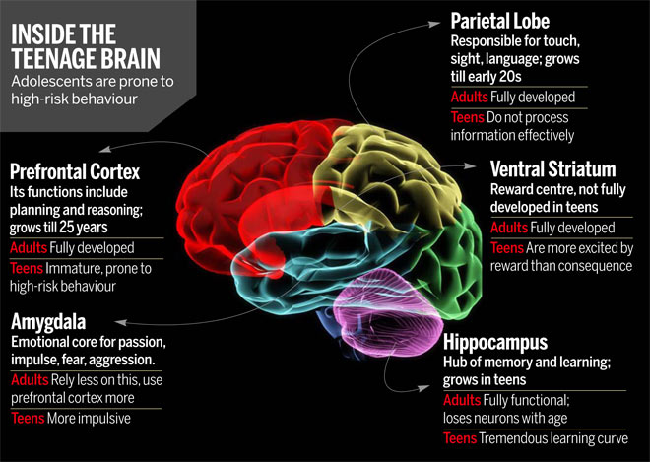
The Effects
Remember the brain is still developing until age 25.
The Prefrontal Cortex is the last to develop.

Slide 34
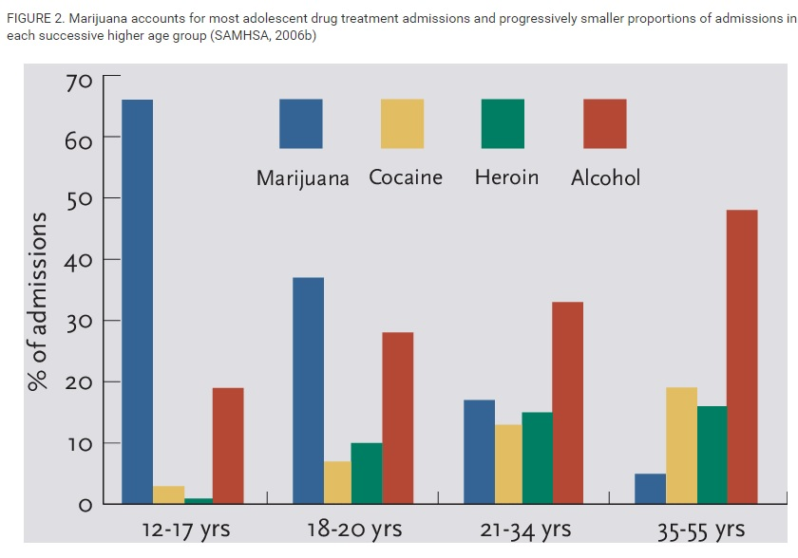
The Effects - Addiction
This is why 1 in 6 teens who use marijuana will become addicted.

Slide 35
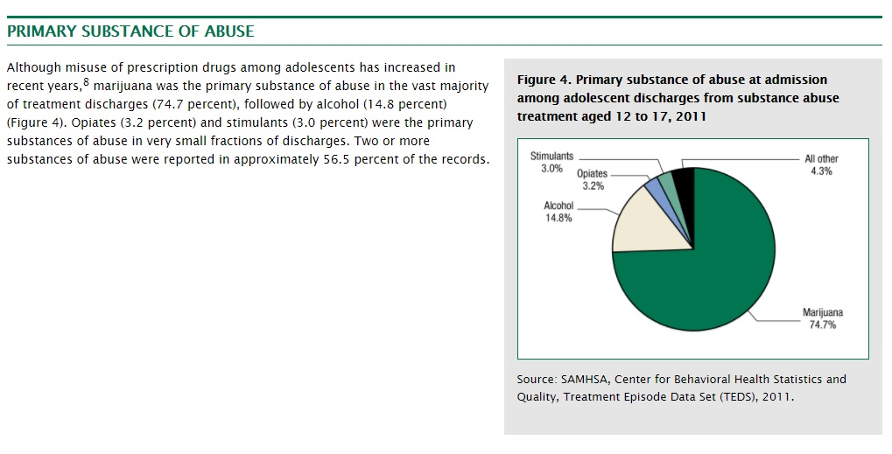
The Effects - Addiction
Treatment centers are reporting marijuana as the primary substance of abuse for those ages 12 – 17 years.

Slide 36
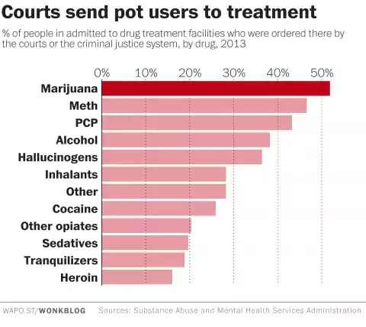
The Effects - Addiction
Marijuana is also addictive to 1 in 20 adults.

Slide 37
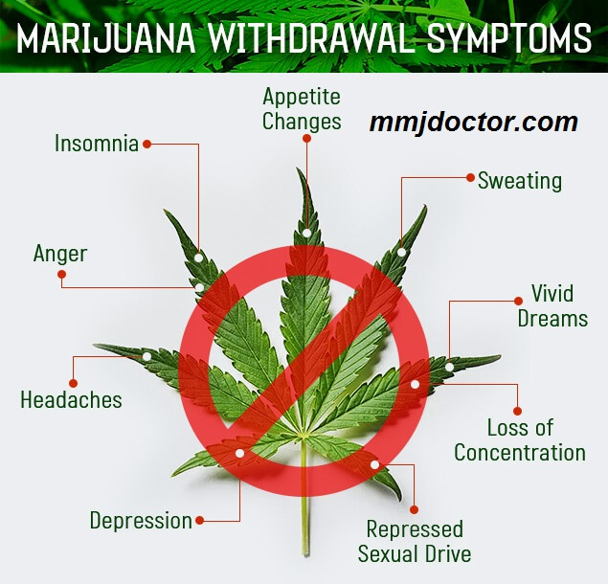
The Effects - Addiction
Most studies suggest that withdrawal symptoms start on the first day of abstinence, and usually peak within the first 2 to 3 days of quitting,
with the exception of sleep disturbance.
Withdrawal symptoms are usually over after 2 weeks, but this depends on how dependent someone is on cannabis before trying to quit.

Slide 38
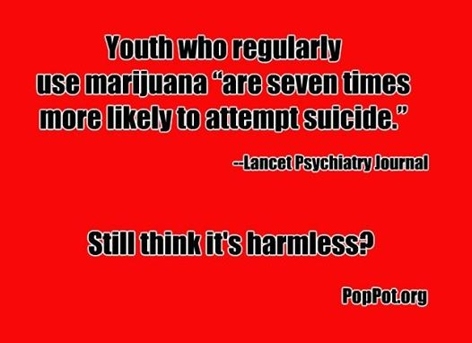
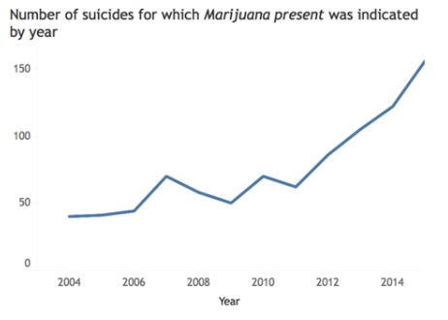
The Effects
The number of suicides where marijuana is present in the body is also on the rise.

Slide 39
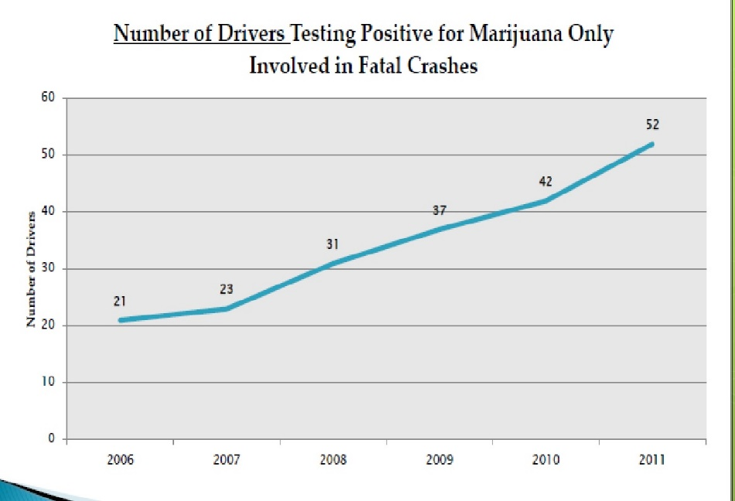
The Effects
Driving under the influence of marijuana (19%) is a greater threat than driving under the influence of alcohol (13%)
Study findings show that teens don’t consider marijuana use a distraction to their driving
Teen passengers are less concerned about riding in a car with a driver who has smoked marijuana than one who has used alcohol
Nearly 1 in 5 teens have gotten behind the wheel after smoking marijuana
Source: “Hazy Logic: Liberty Mutual Insurance/SADD Study Findings Driving Under the Influence of Marijuana a Greater Threat to Teen Drivers than Alcohol.” Liberty Mutual Press Release. February 22, 2012. http://www.sadd.org/press/presspdfs/marijuana%20Teen%20Release.pdf

Slide 40
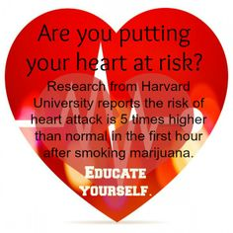
The Effects
Marijuana can cause the heart rate to increase
by 20 to 50 beats per minute.
This increase can last for hours after use has stopped.
Source: Volkow et al., Psychiatry Research: Neuroimaging, 67, pp. 29-38 (1996). This slide is from: Volkow, ND (2011) Marijuana’s Effects on Brain, Body and Behavior. Presentation March 8, 2011.

Slide 41
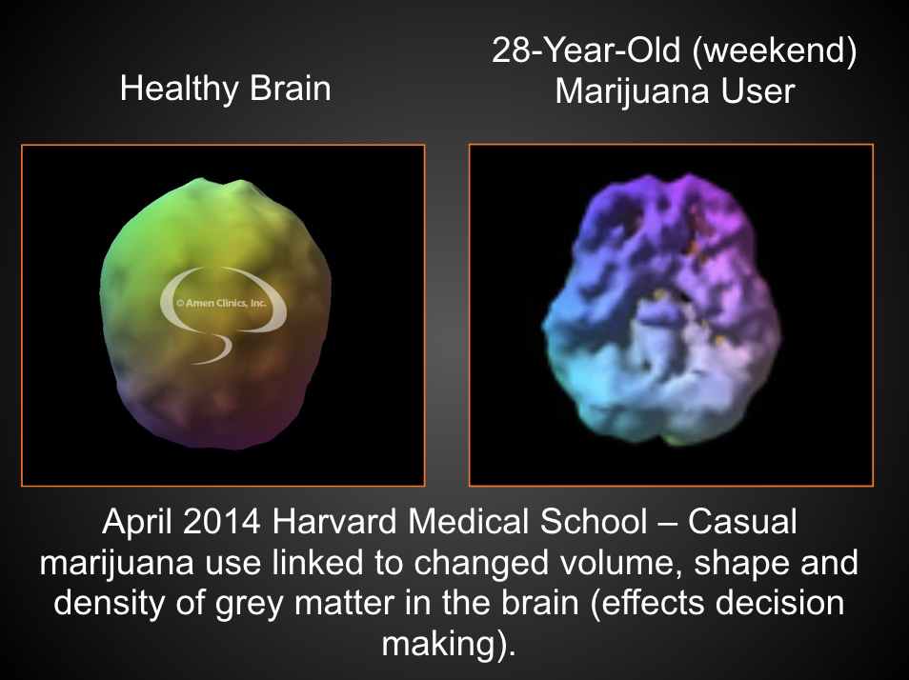
The Effects
Over time, regular exposure to THC can permanently alter how the brain works, even if the drug is not currently being used.

Slide 42
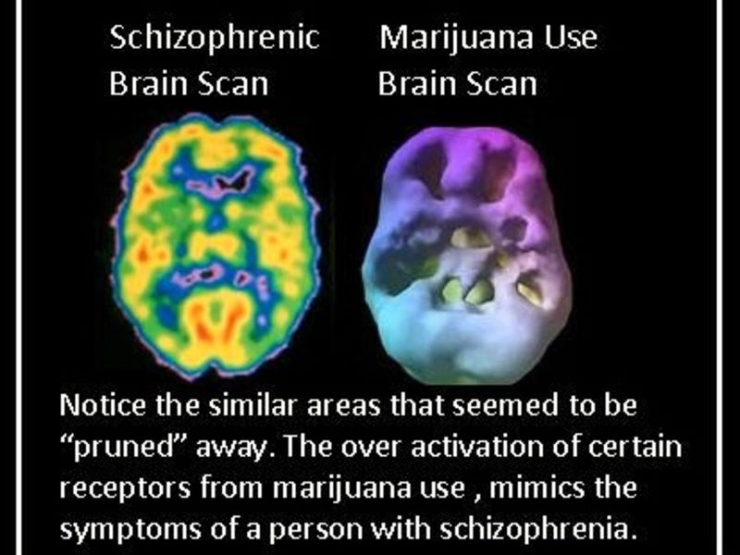
The Effects
https://patch.com/illinois/evanston/link-between-schizophrenia-marijuana-cannabis-use

Slide 43
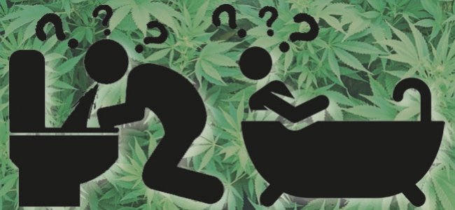
The Effects - CHS
Cannabinoid Hyperemesis Syndrome (CHS)
"I've screamed out for death," said Queen, 48, who lives in San Diego. "I've cried out for my mom who's been dead for 20 years,
mentally not realizing she can't come to me."
Patterns of cyclical vomiting and abdominal pain, often using hot baths and showers to control symptoms

Slide 44

The Effects - CHS
Cannabinoid Hyperemesis Syndrome (CHS)
After medical marijuana was legalized in 2009, the prevalence of cyclical vomiting visits associated with cannabis doubled in two Colorado hospitals
With prolonged vomiting, there is risk for dehydration and ensuing kidney failure
Doctors can do little to relieve the symptoms & traditional
anti-nausea medications have no effect
There is no cure other than to quit using marijuana
https://www.forbes.com/sites/robertglatter/2016/12/30/syndrome-linked-to-smoking-weed-spikes-in-states-with-legalized-marijuana/#57189c7a63d7

Slide 45
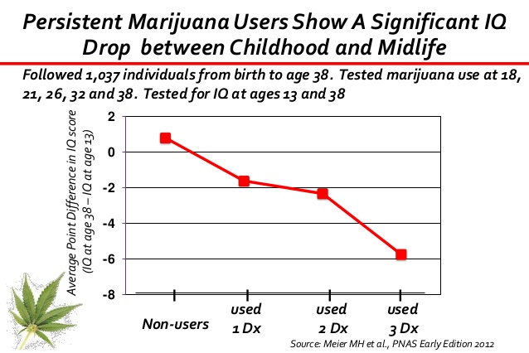
Future Effects
Study findings showed individuals who used marijuana heavily in their teens and continued through adulthood had a drop in IQ between ages 13 to 38
Average of 8 points for those who met a diagnosis of marijuana dependence
Loss of 8 IQ points could drop a person of average intelligence into the lowest third of the intelligence range

Slide 46


Future Effects
Research shows that teen marijuana use :
Lowers academic performance
Increases truancy & drop out
Reduces likelihood of graduation
Higher risk of future unemployment
Students who are cited for illegal drug use/possession while receiving student financial aid may be at risk for losing their financial aid and/or federal student loans
Source: Jacobus, J, Bava, S. et. al. (2009) Functional Consequences of Marijuana Use in Adolescence . Pharmacology, Biochemistry and Behavior 92(4
Source: U.S. Dept. of Education "Students with Criminal Convictions Have Limited Eligibility for Federal Student Aid."

Slide 47
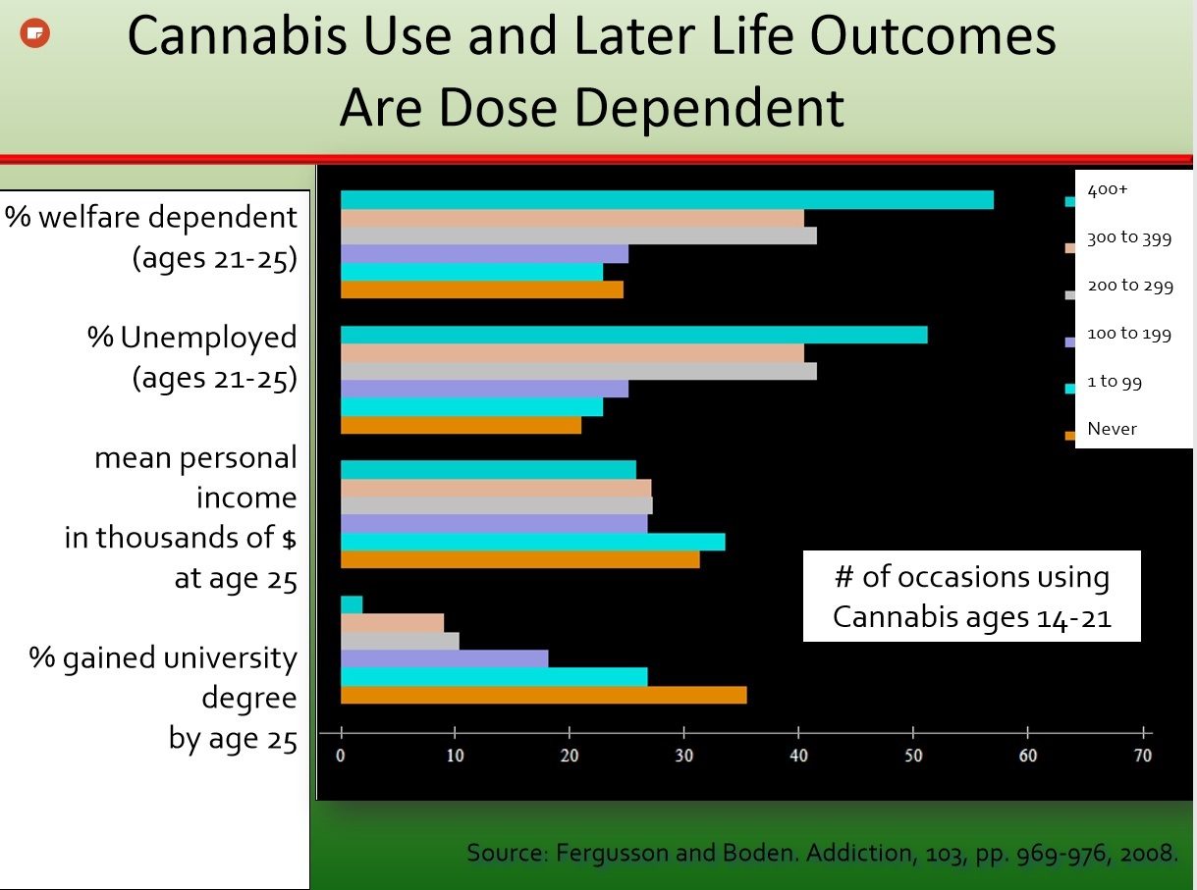
Future Effects
Long term studies also show less positive life outcomes with higher rates of use.

Slide 48
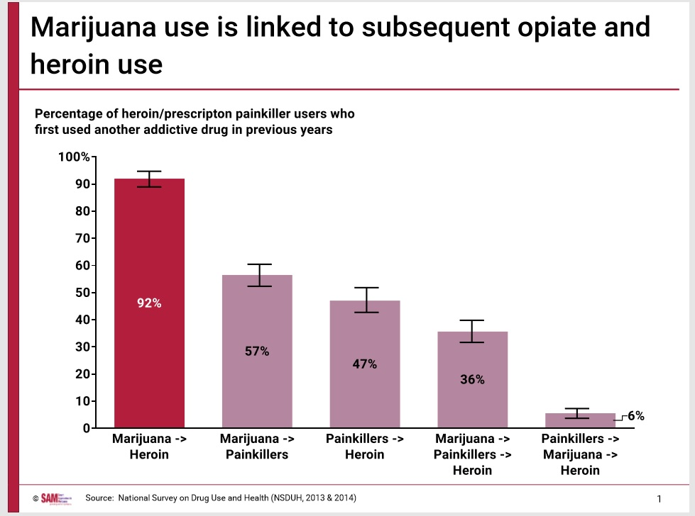
Future Effects
Most marijuana users move to heroin as their next drug of choice.

Slide 49
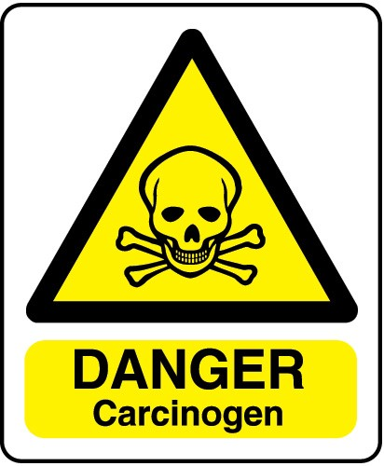
Hidden Hazards
The California’s Office of Environmental Health Hazard Assessment placed marijuana smoke on its official list of known carcinogens in 2009.
The amount of tar inhaled by marijuana smokers and the level of carbon monoxide absorbed are three to five times greater than from tobacco smoke
Marijuana contains more cancer causing chemicals than tobacco
Marijuana smokers inhale deeply and hold the smoke in their lungs longer which may increase their risk for developing lung cancer
The British Lung Foundation (2012) The Impact of Cannabis on Your Lungs.

Slide 50

Hidden Hazards
"It's really like injecting that pesticide right into your bloodstream."
The body doesn't filter the pesticides when inhaled like it does when you eat something with the same chemicals on it
Some pesticides become more dangerous when they're heated up or burned (i.e. dabs)
Myclobutanil can turn into hydrogen cyanide when it's heated up (Hydrogen cyanide has been used in gas chambers
to kill people)
https://www.nbclosangeles.com/news/local/I-Team-Marijuana-Pot-Pesticide-California-414536763.html

Slide 51

Remember…

Slide 52

We CAN Make a Difference
http://www.maine.gov/dhhs/samhs/

Slide 53

We CAN Make a Difference
Increasing Perception of Harm Decreases Use

Slide 54

We CAN Make a Difference
http://www.maine.gov/dhhs/samhs/

Slide 55

We CAN Make a Difference
http://www.maine.gov/dhhs/samhs/

Slide 56

We CAN Make a Difference
http://www.maine.gov/dhhs/samhs/

Slide 57
What To Do Next
I thought this would be a good place to promote the SCCY and how they can get involved as well as the talking tips from the Future Forward Campaign.

